Slide 1
NSU Shuttle System
CSE327 Project
Group Members:
Md shadman zarif (1931796042)
Shajeda Parvin (1931313042)
Md Razib Ahsan (1931621642)
Md Zahin Faiyaz Islam (1912207642)

Slide 2
Overview
The NSU Shuttle System is a Web application meant for easing the services for the Students and Faculties. This web application will help to run the daily Transport service smoothly. The NSU services system is developed to help the student to safely reach at NSU on time, help students and teachers save time, cut costs. This will help the students and faculties in order to managing transportation. In today’s busy lifestyle, it is difficult for students to wait for a public transportation. This service system will make transportation easier for the students; in fact it will be easier for each individual person who is associated with the system.

Slide 3
Problem statement
The students & faculties of NSU faces issues just due to the lack of automation. At present the student & faculties are facing lack of safe transportation while commuting from and to NSU.

Slide 4
Vision Statement
The aim of NSU shuttle is to provide a comfortable travel experience to and from NSU; it will make transportation easier for the students, faculties and other members of NSU. We focus on giving our users a responsive user Interface, easy registration and login process & further an easy seat booking experience.

Slide 5
Functional Requirements
Functional requirements
Passenger Side:
Create an account
Log in to the system
Booking a seat
Seeing Travel log
Functional requirement
Admin Side:
Log in to the system
Adding & Removing Vehicle
Adding & Removing Route
Seeing Booking List
Count Passenger for a particular trip
Confirming a Trip

Slide 6
NSU Shuttle System Description
There are two types of main users will be involved in the NSU management system; each of the users are an important entity of this management system:
Admin(Shuttle)
Passengers
Admin:
Admin has the power to create, update or delete any record of the system under their domain.
The admin will be able to see all the details under their domain.
The admins of this system are like service providers; thus, they will manage all the services under each admin domain.
Passengers:
The passengers can create account & log into the system.
They can book their ride from or to NSU through the service.
They can view their travel log.

Slide 7
Getting Started
Registration: The service system will have an easy registration system; students will have to use their NSU ID & the faculties will use their initials and then they will use their name, email & password to register. The eligibility for the entered information in order to be able to register to the system will be verified and the registration will be completed.
Login: After successful completion of the registration process, the user can log in to their account by entering the NSU ID and the password. If a valid ID and according password is provided on then the user is granted access.
Booking: Passengers will select route, way, time and date to book their seat.

Slide 8
Technologies Used
React JS Framework
Node JS Framework
Express JS
MongoDB

Slide 9
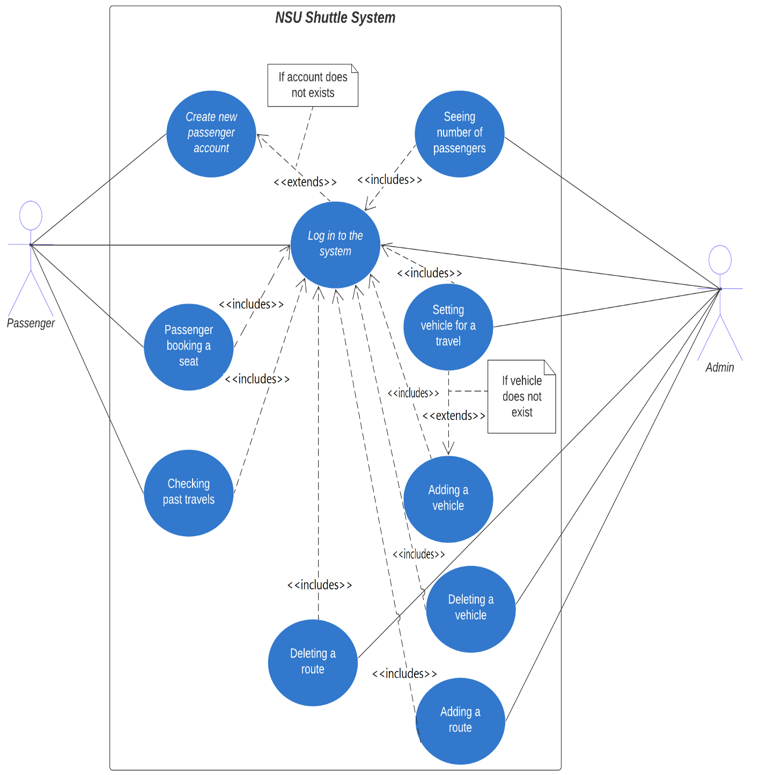
Use CASE Diagram:

Slide 10
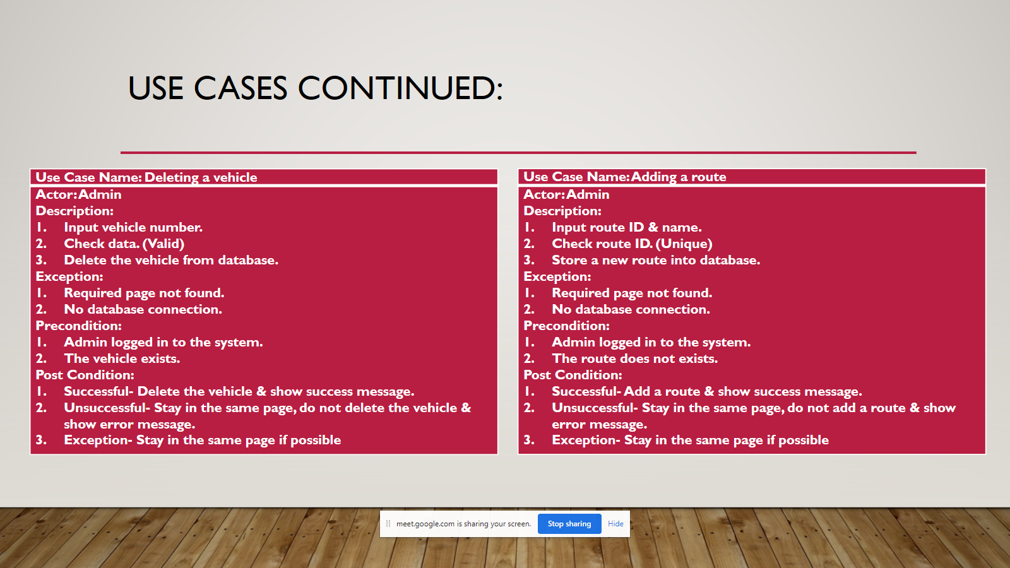
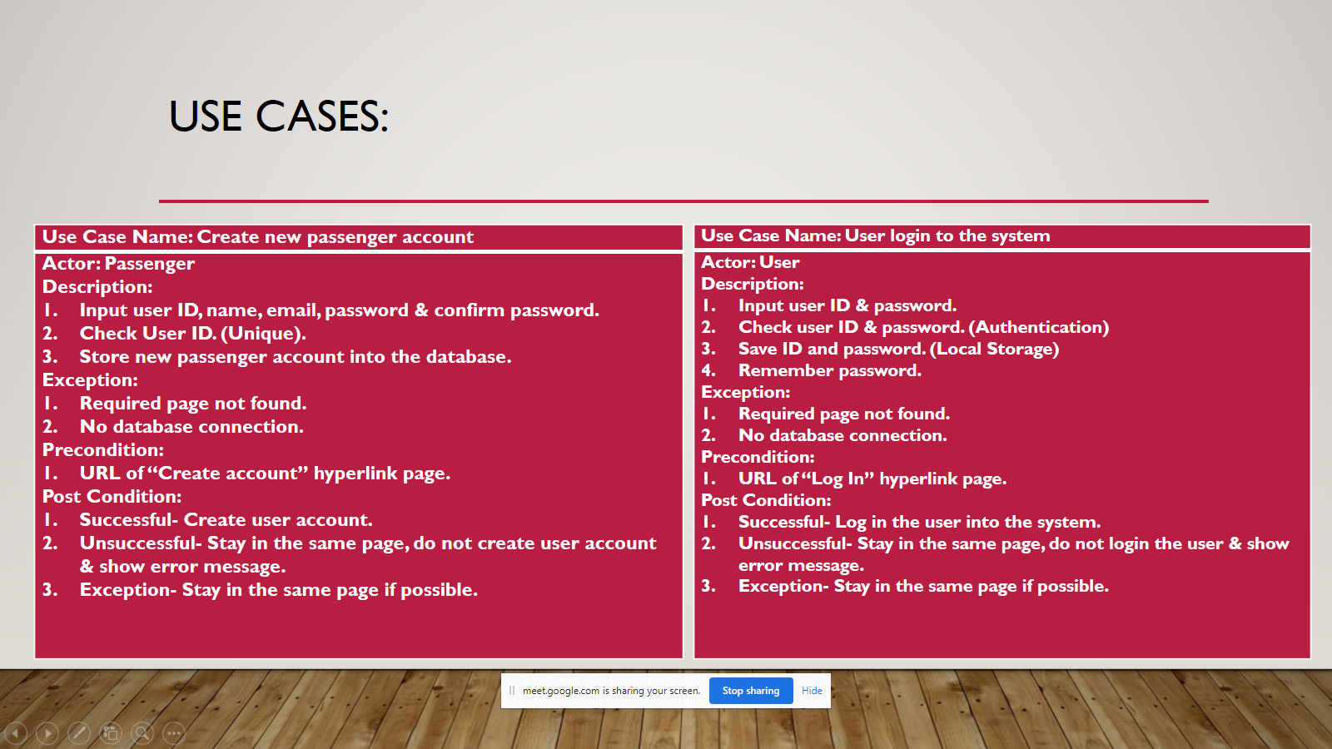
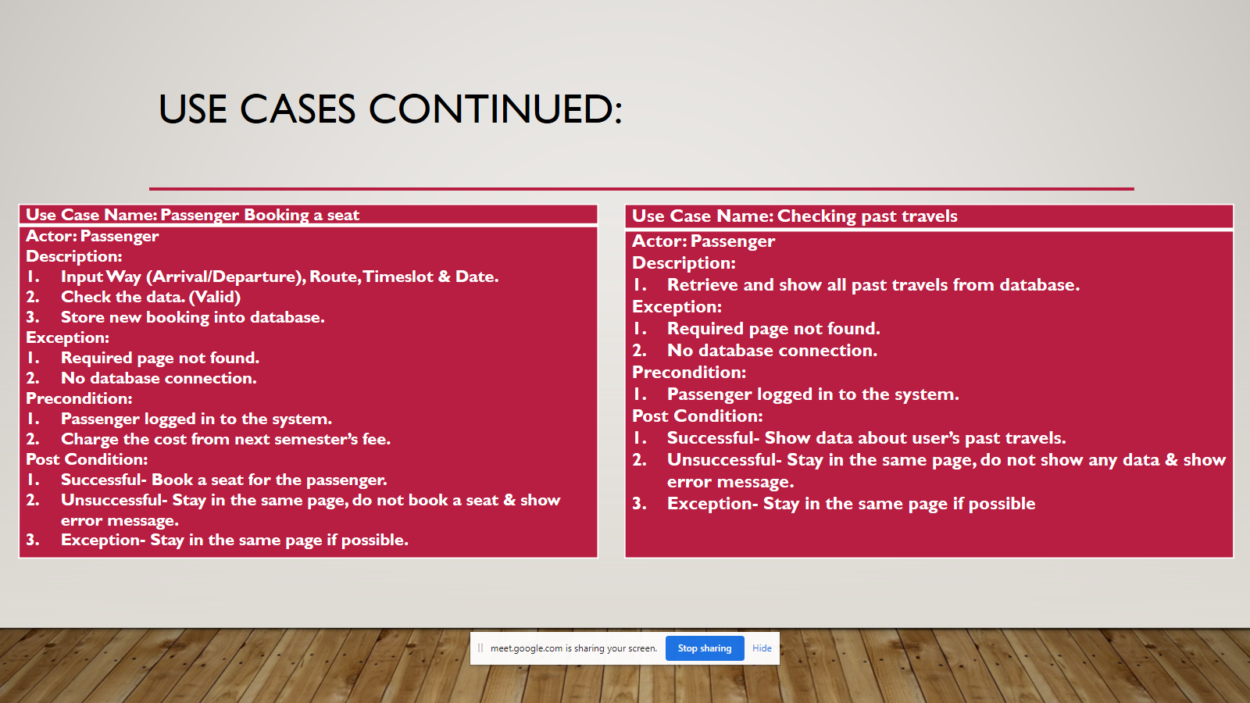
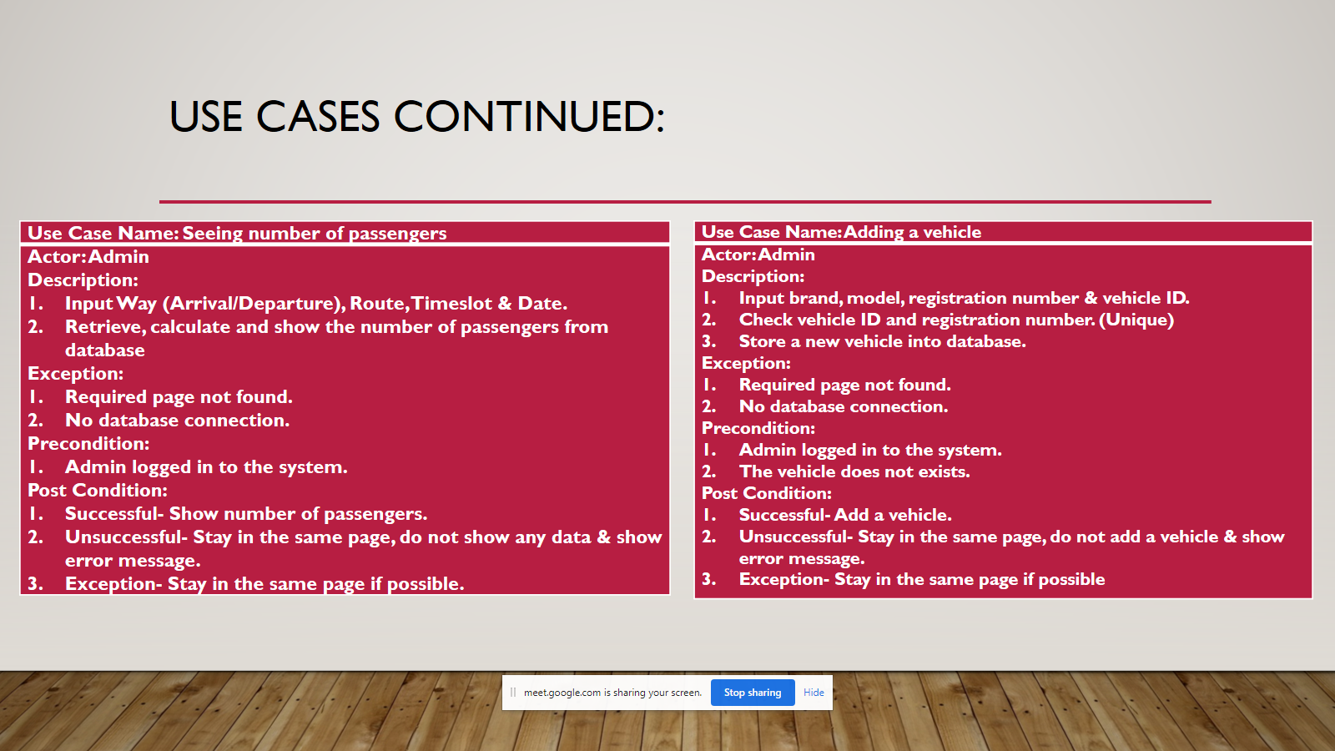
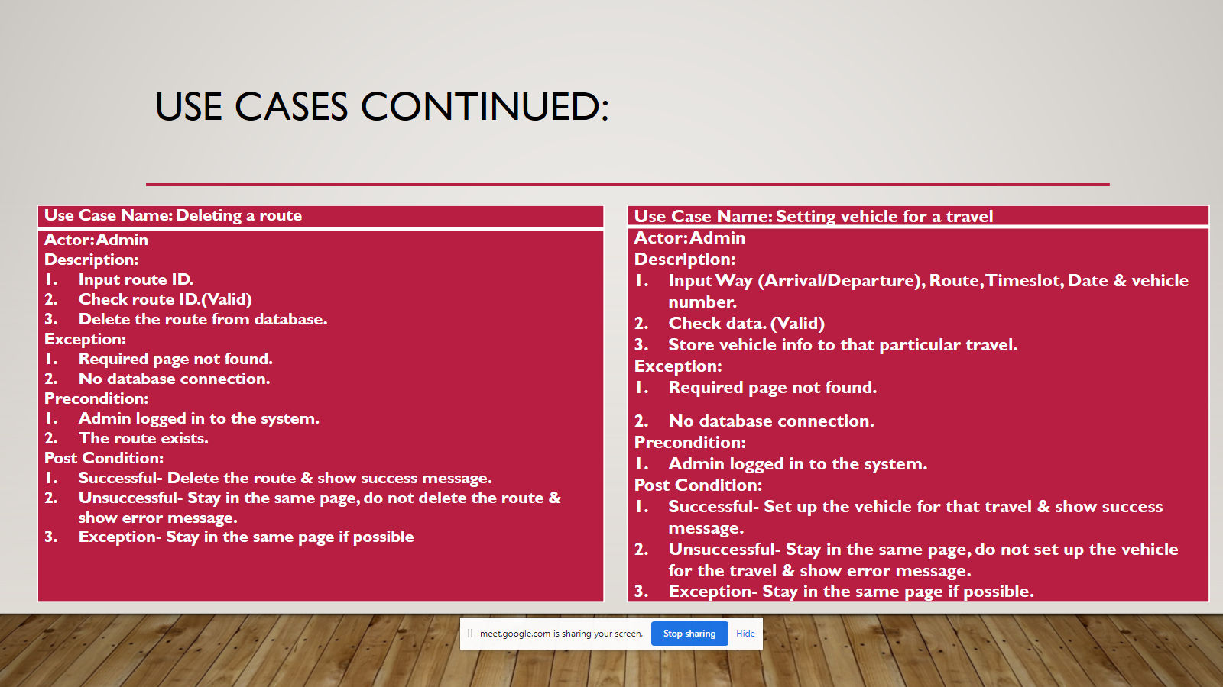
Use Cases:

Slide 11
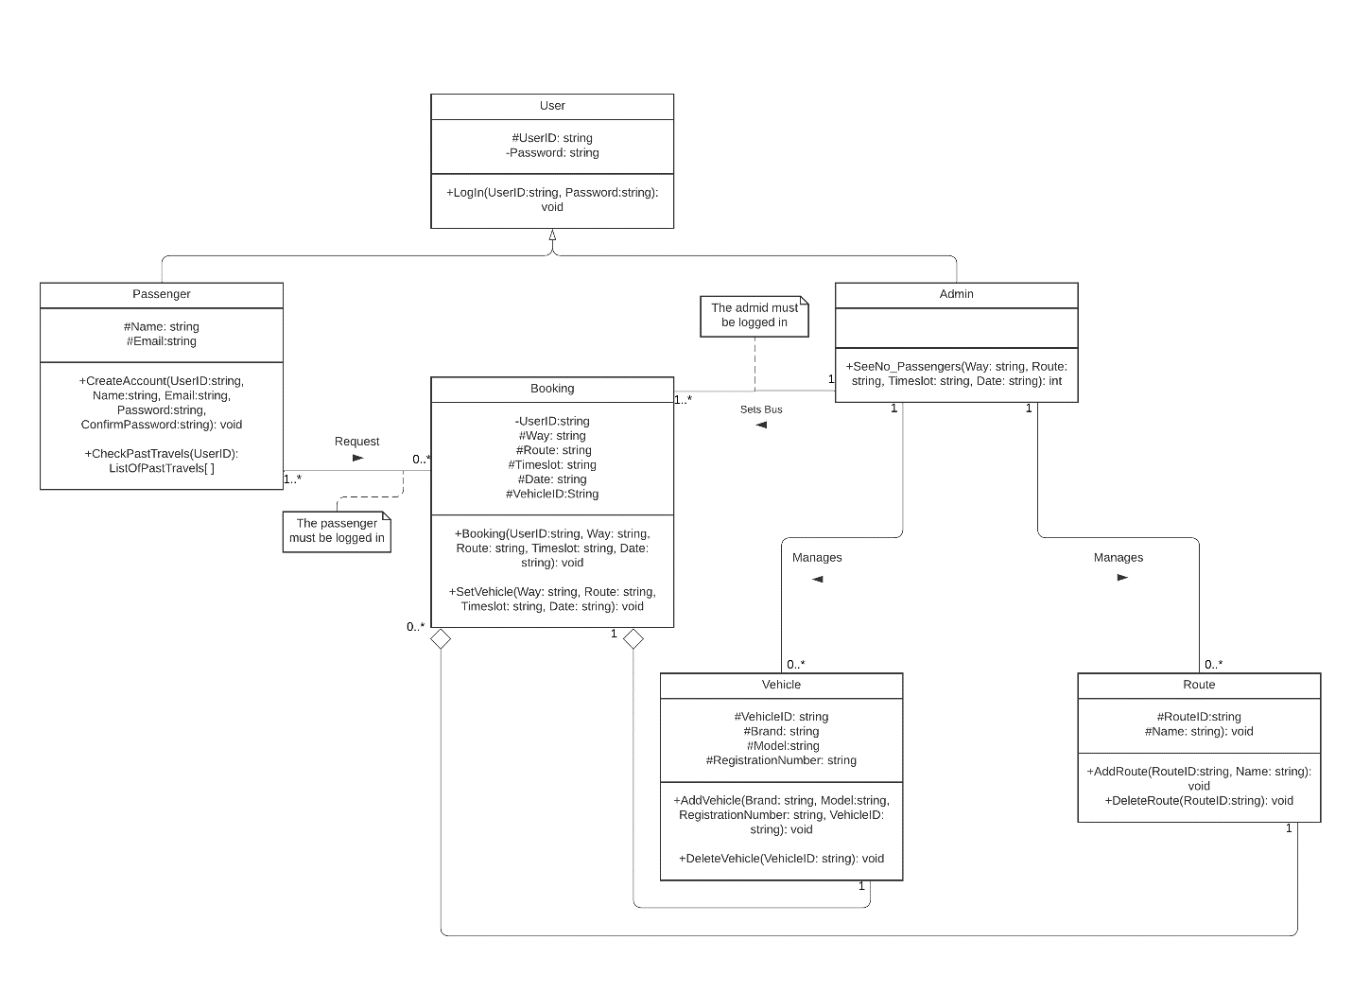
Class Diagram:

Slide 12
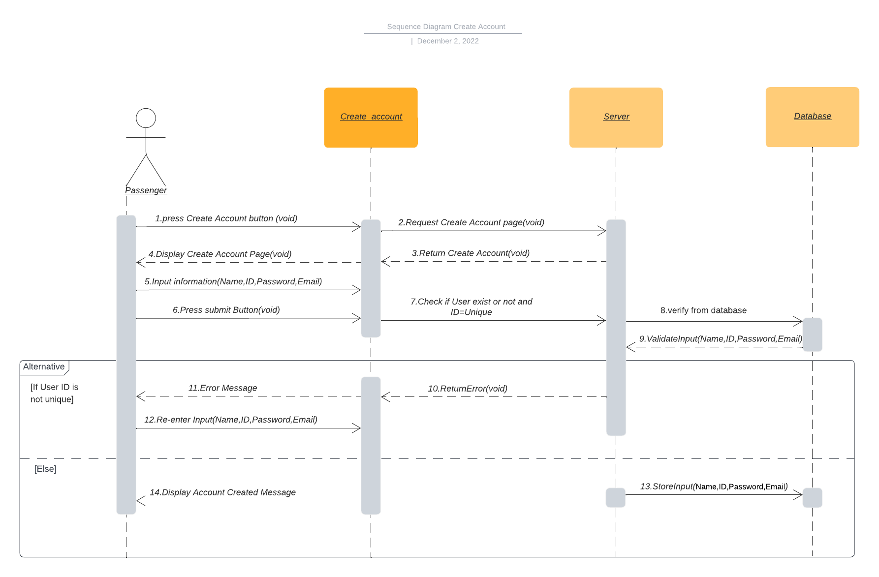
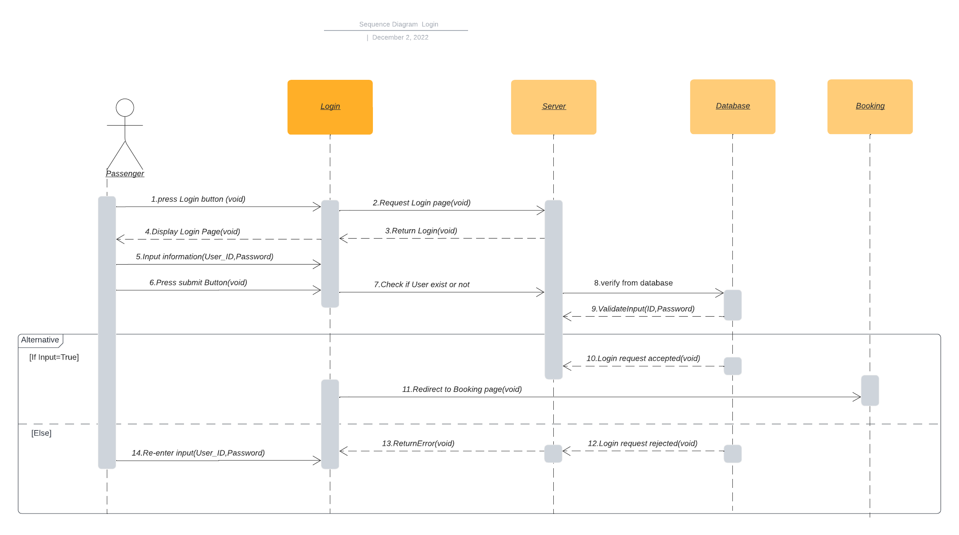
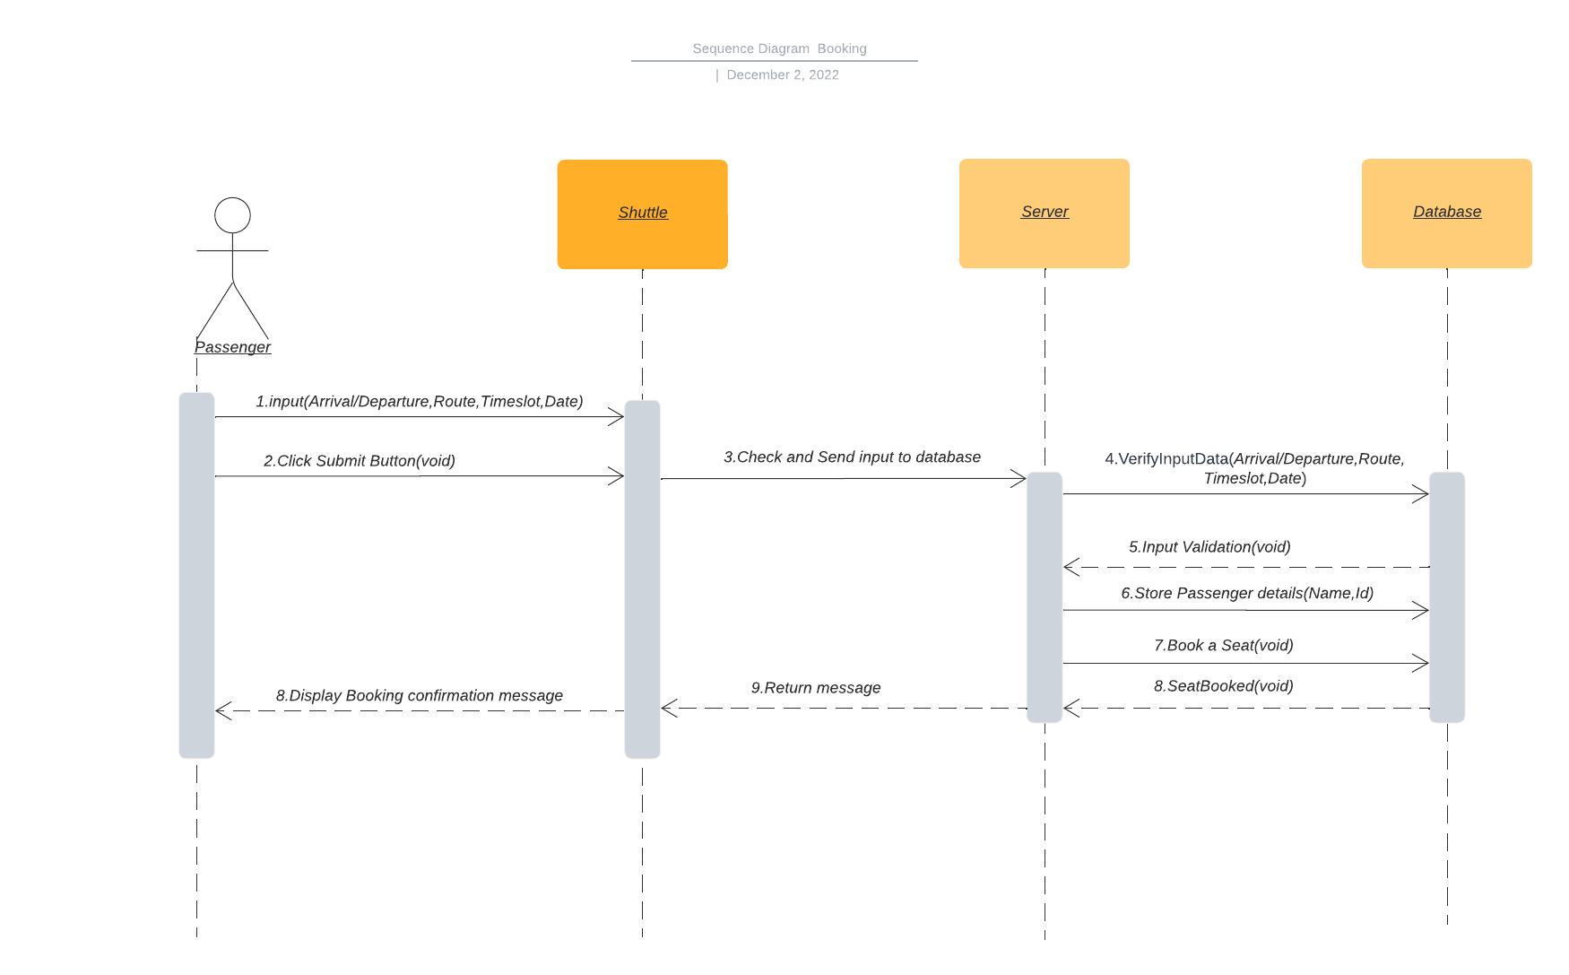
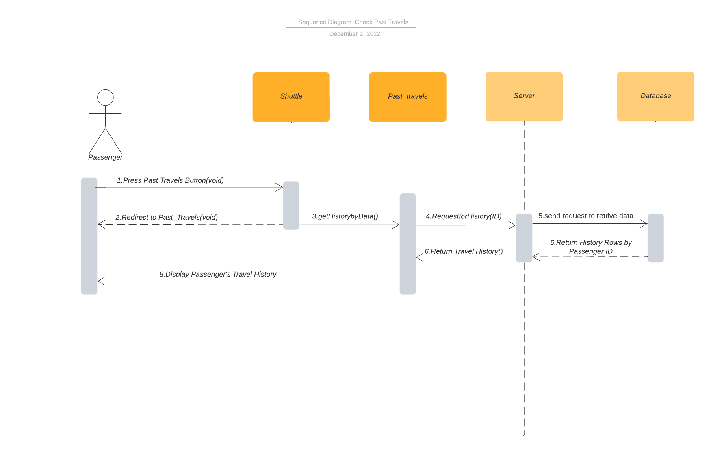
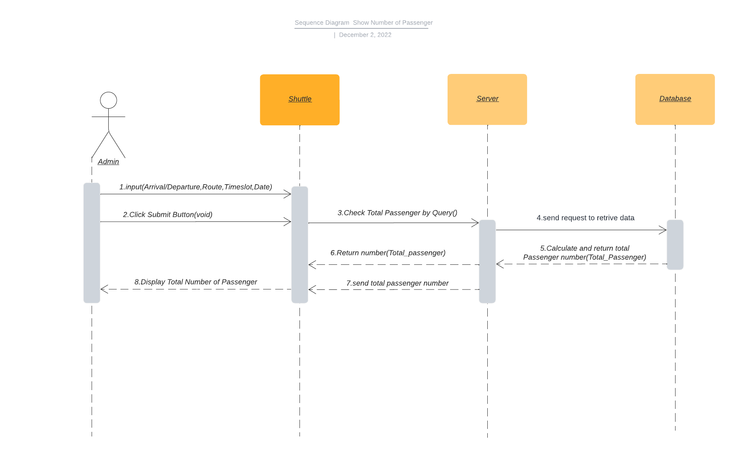
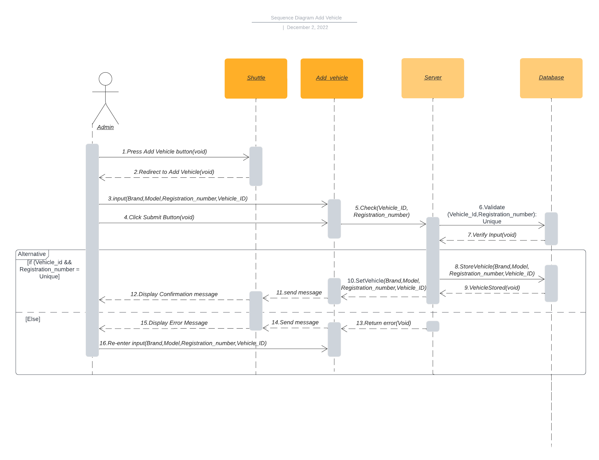
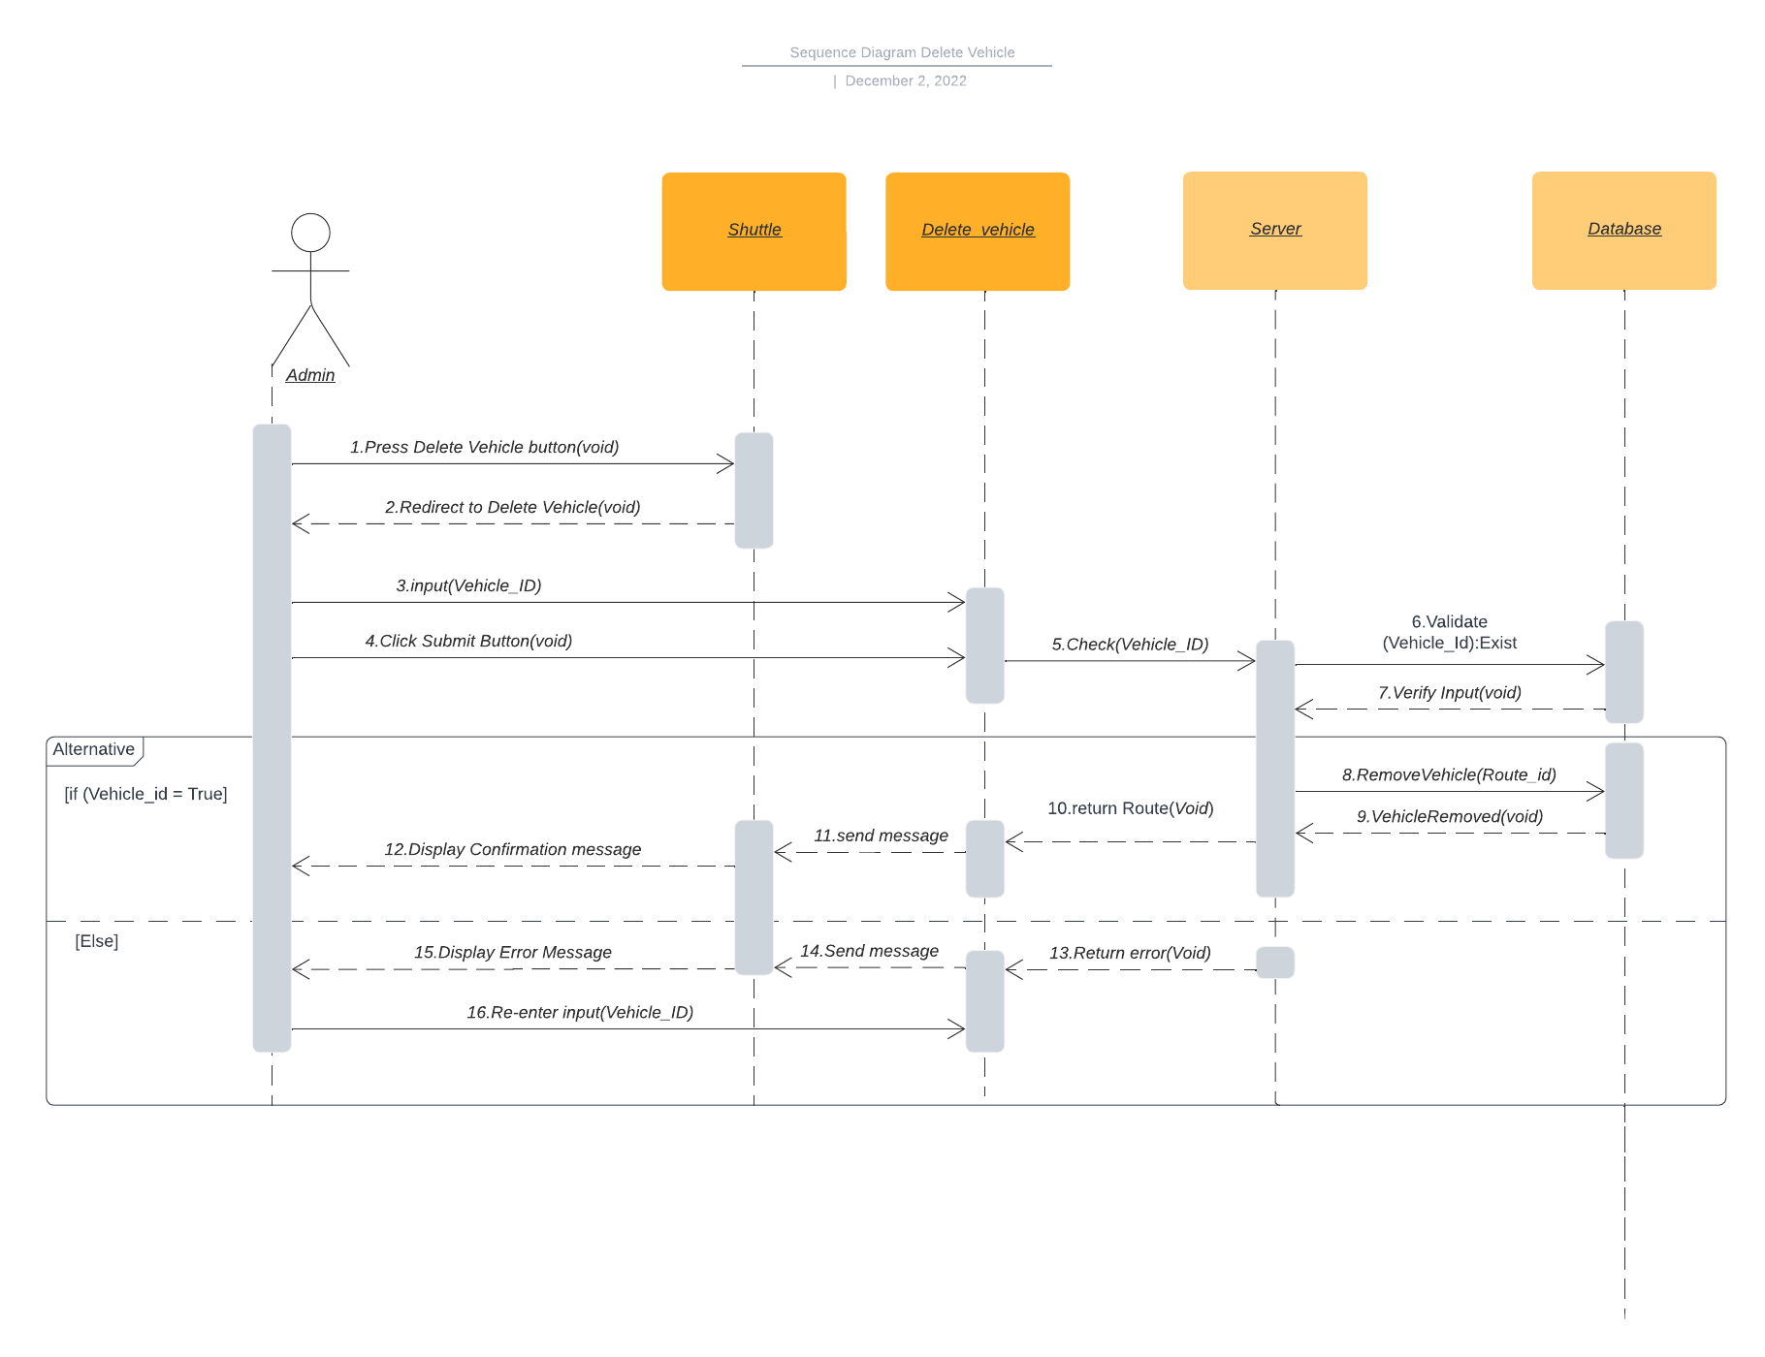
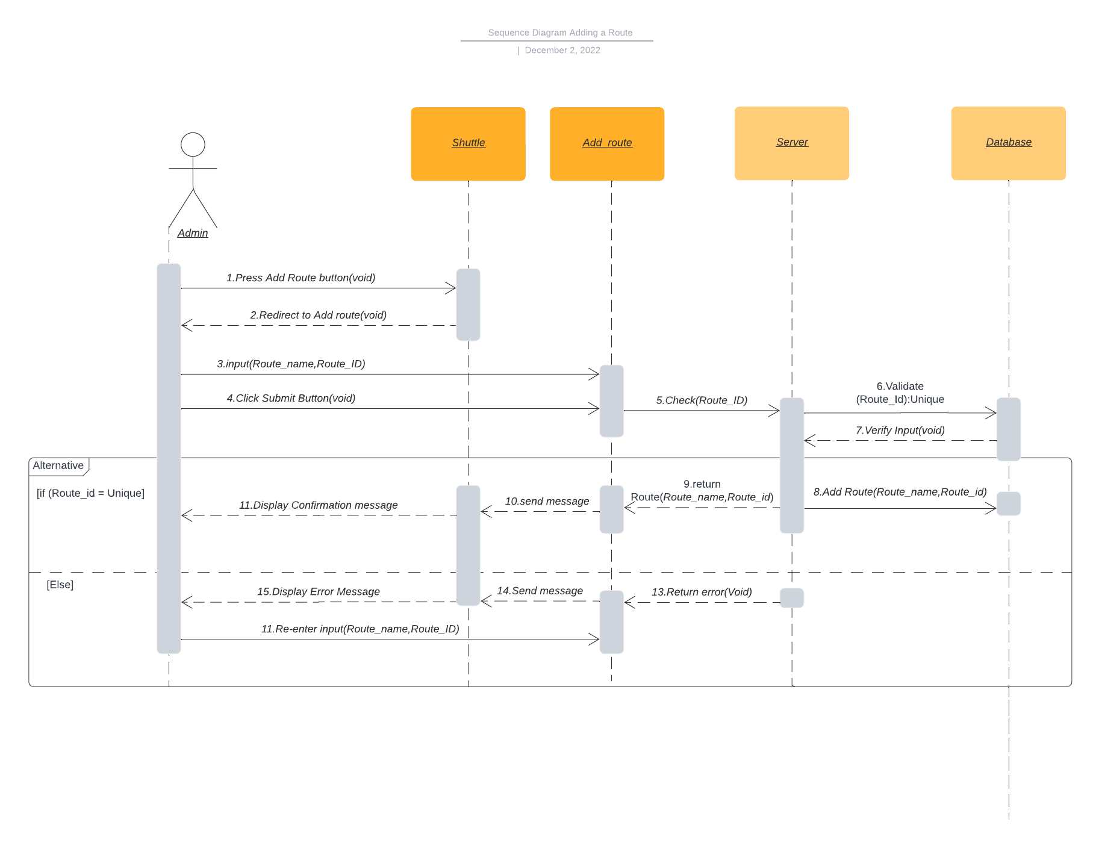

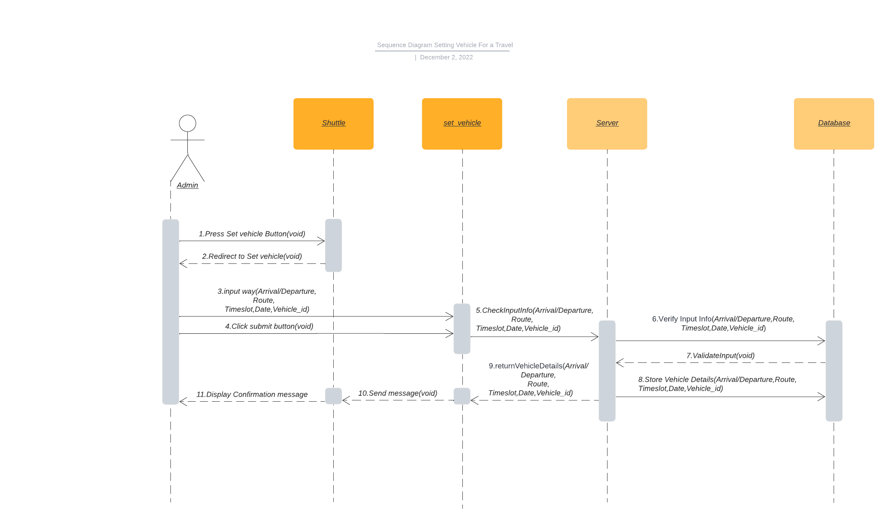
Sequence Diagram:

Slide 13
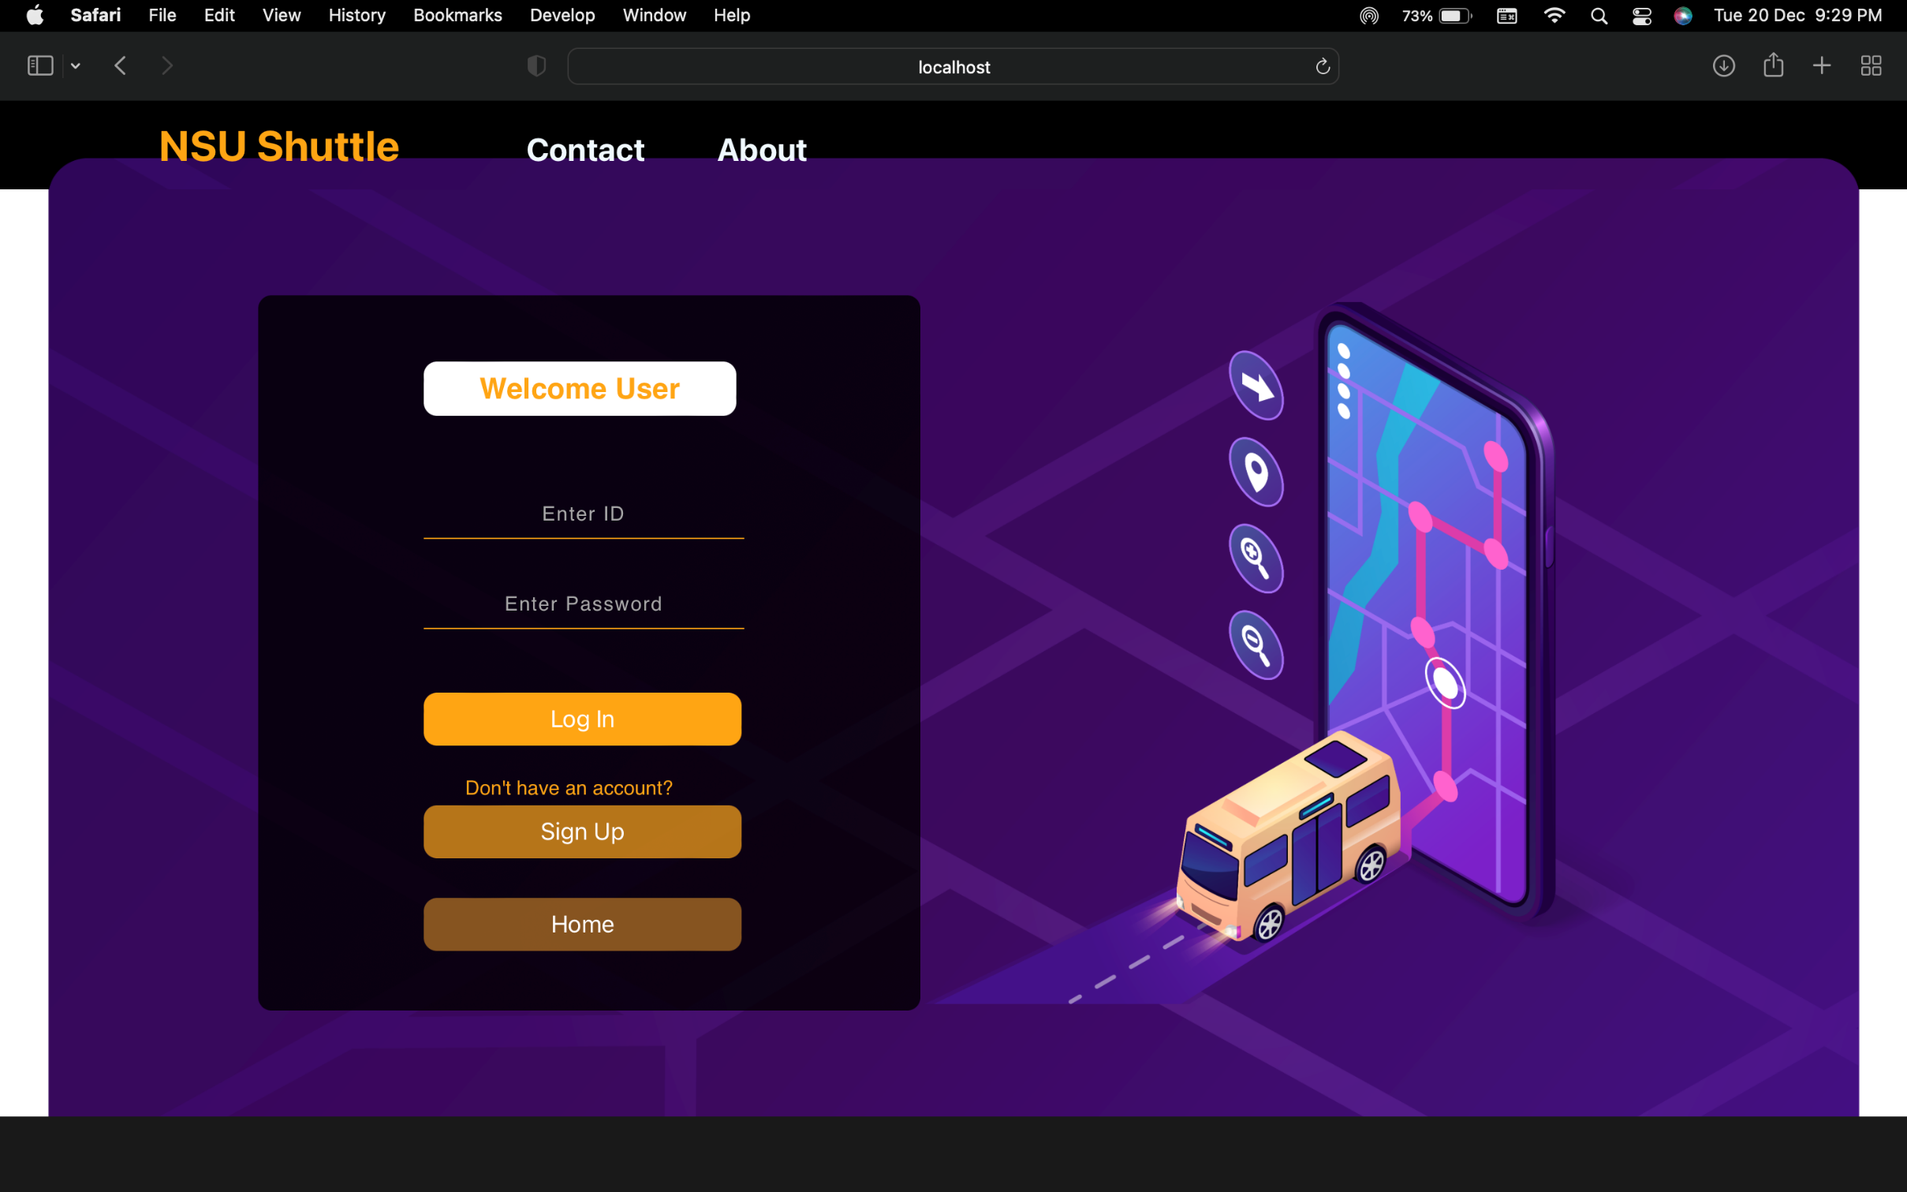
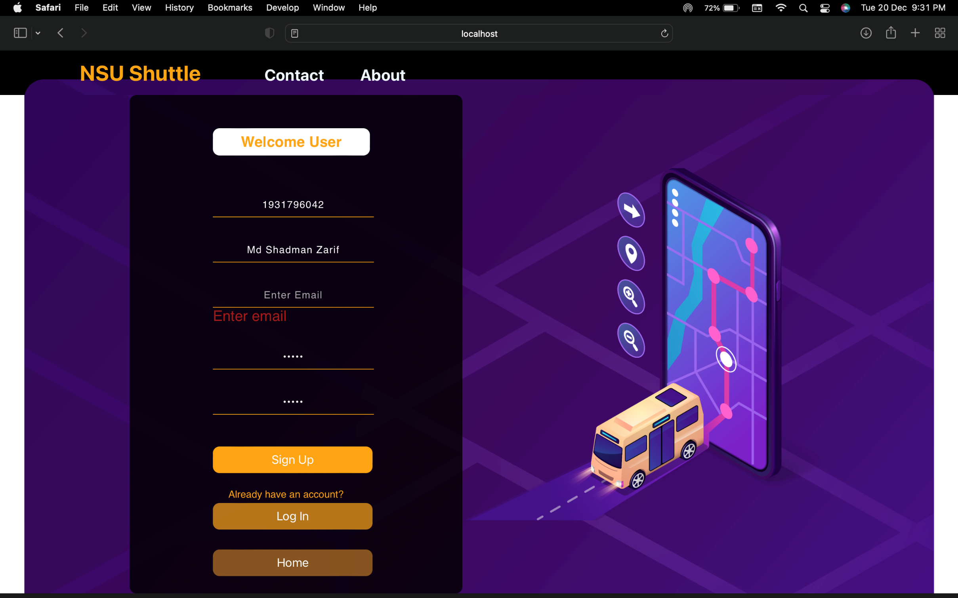

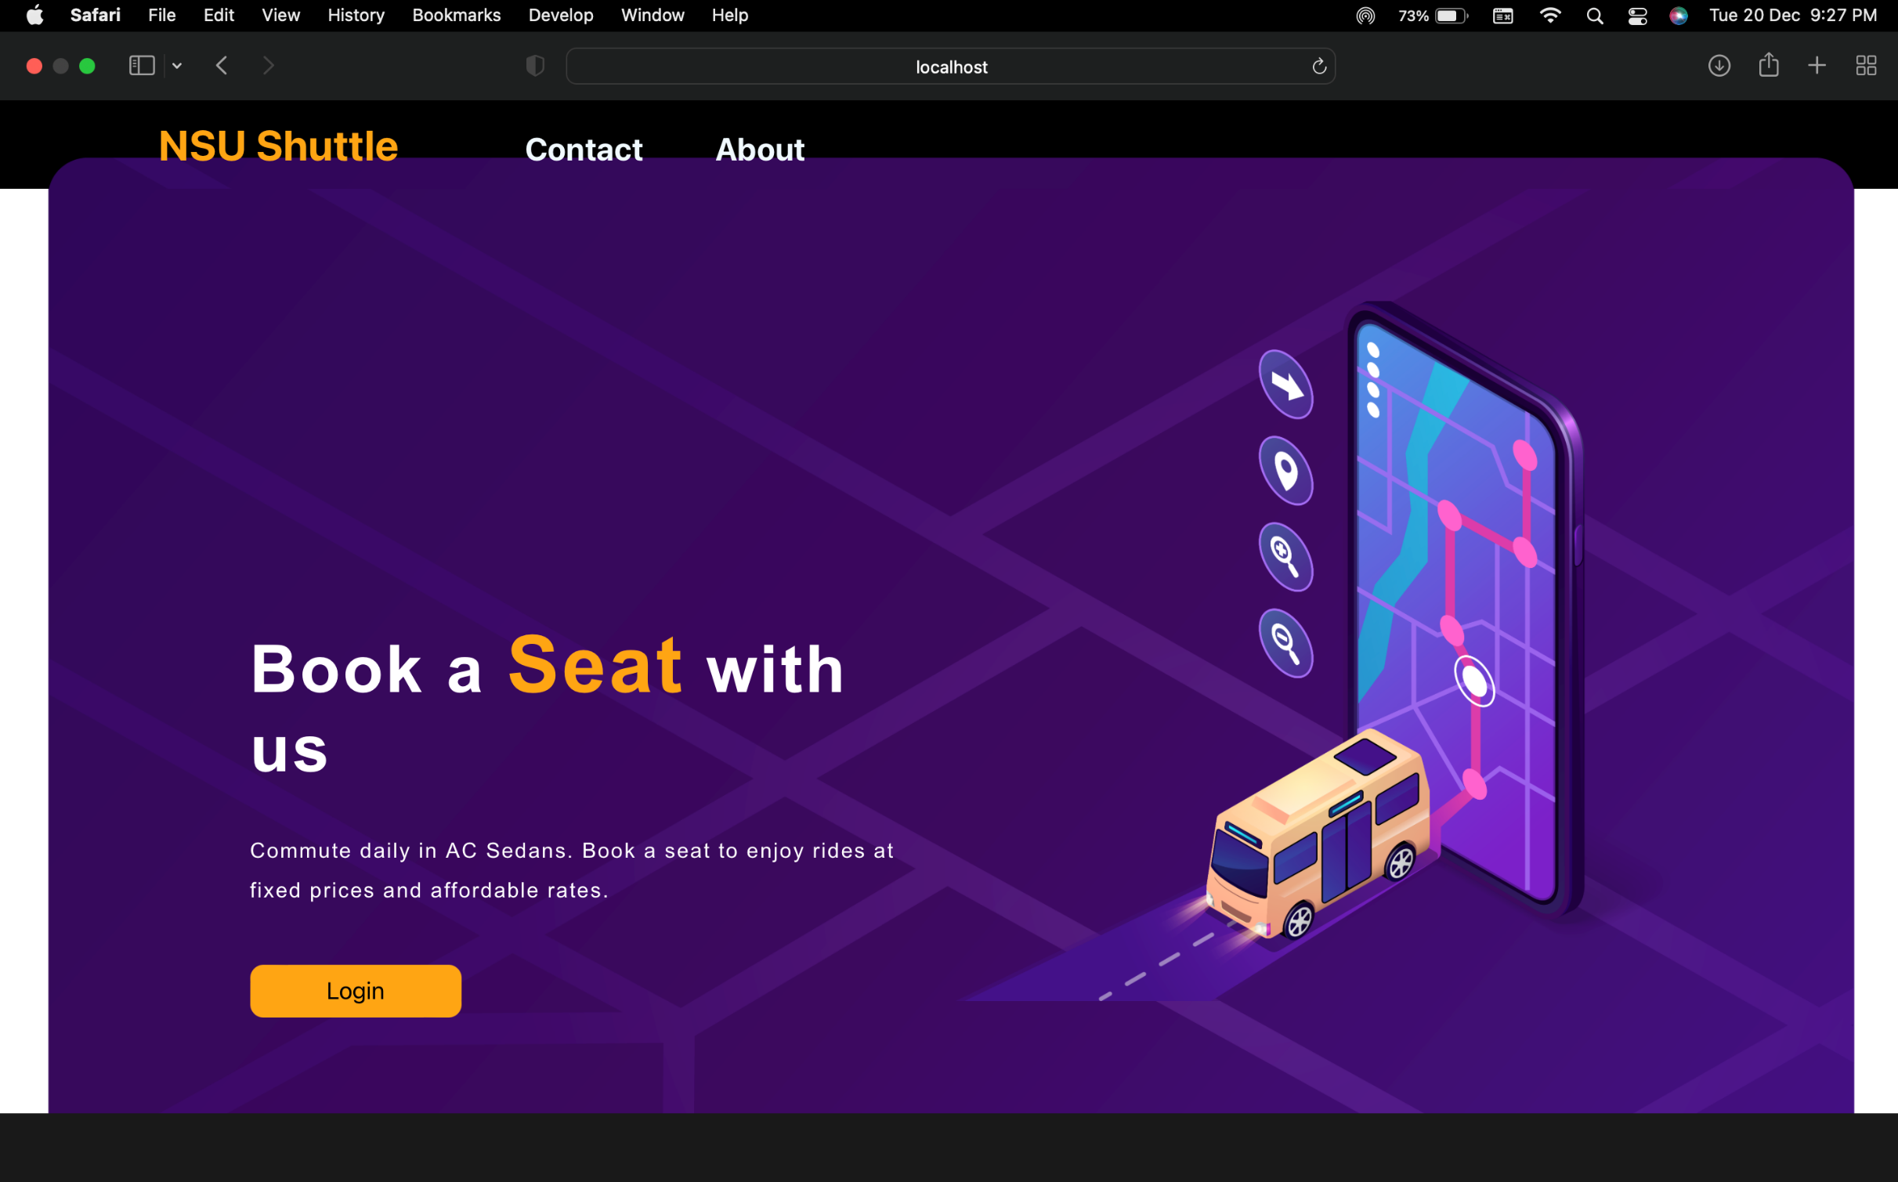
Implementation & Testing:

Slide 14
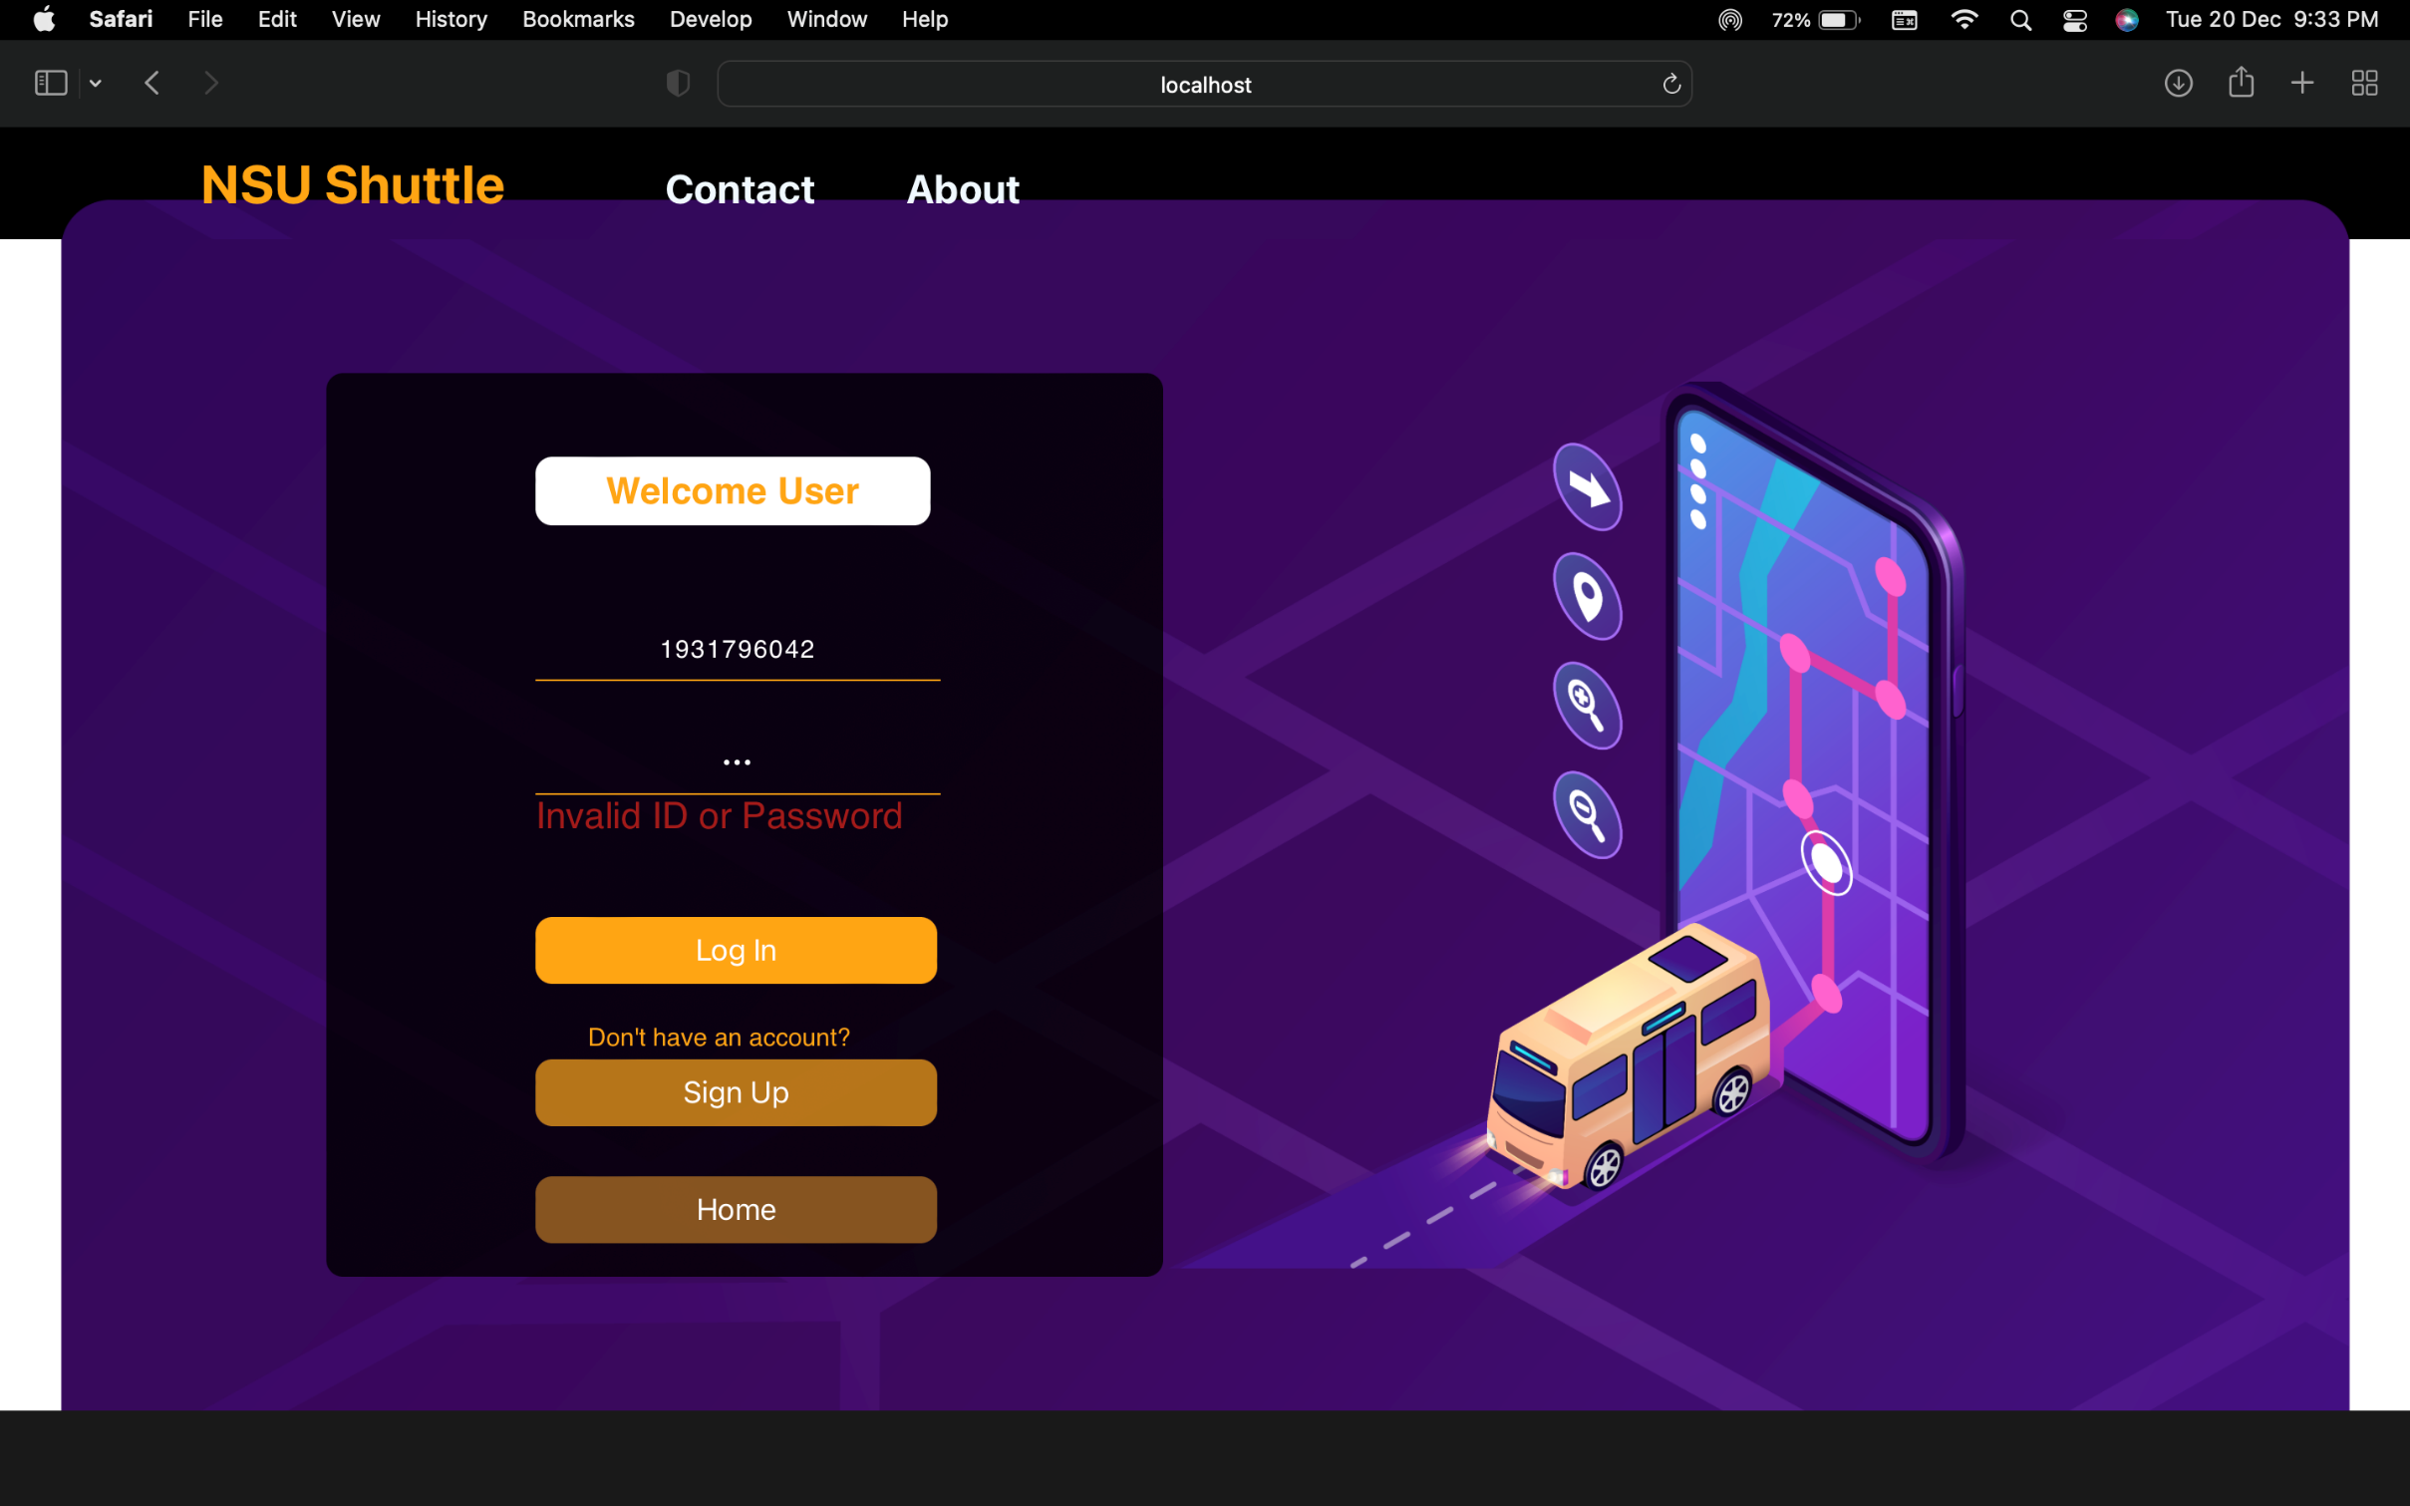
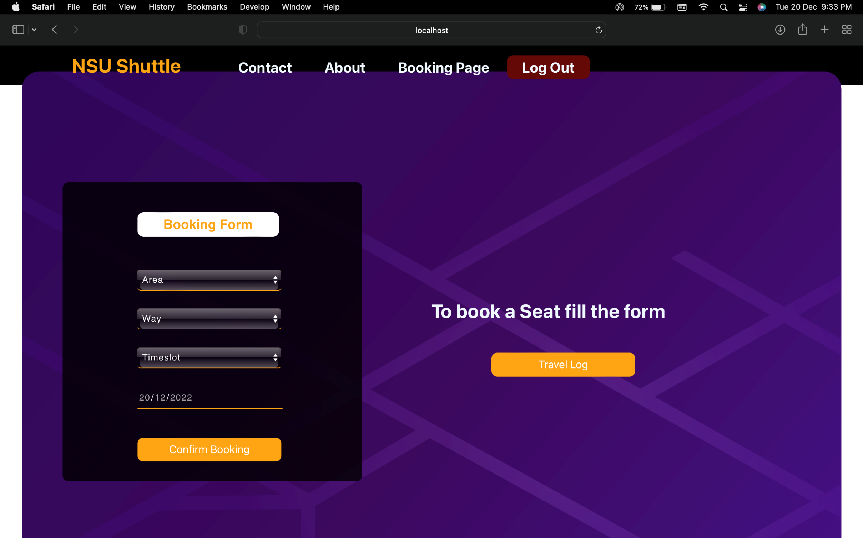
Implementation & Testing:

Slide 15
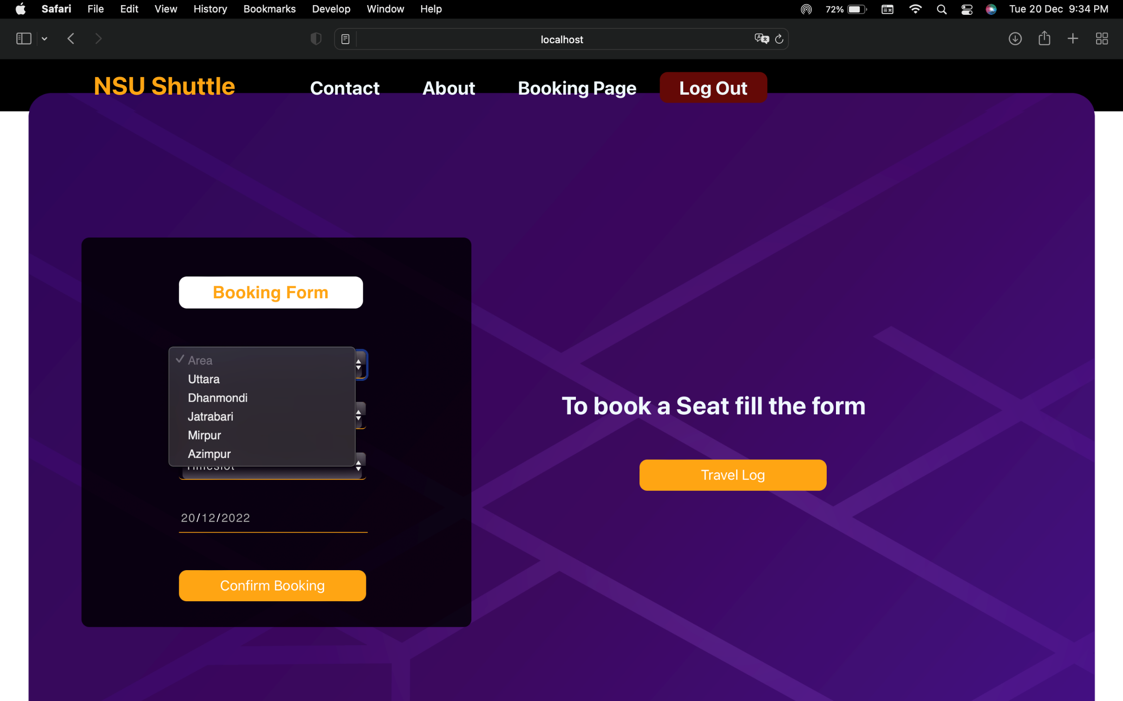
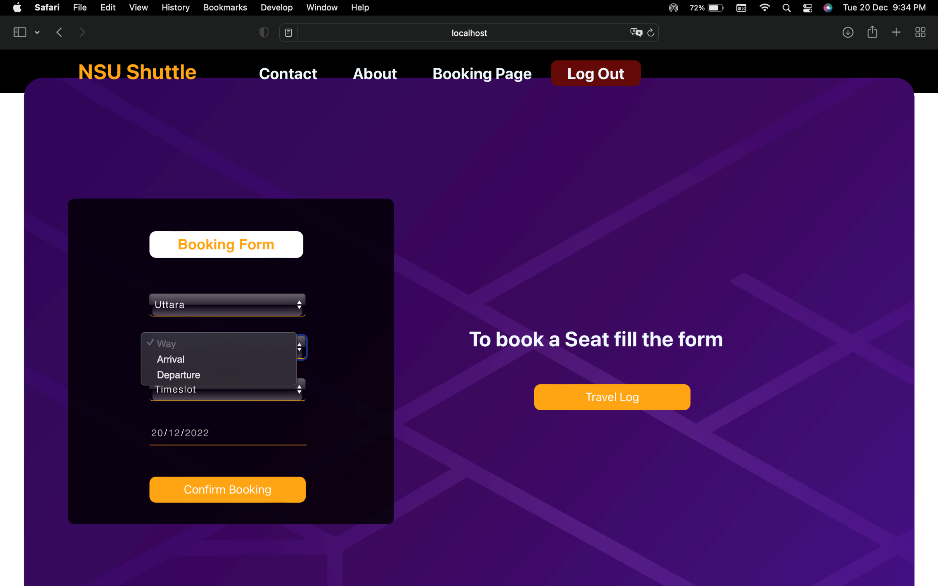
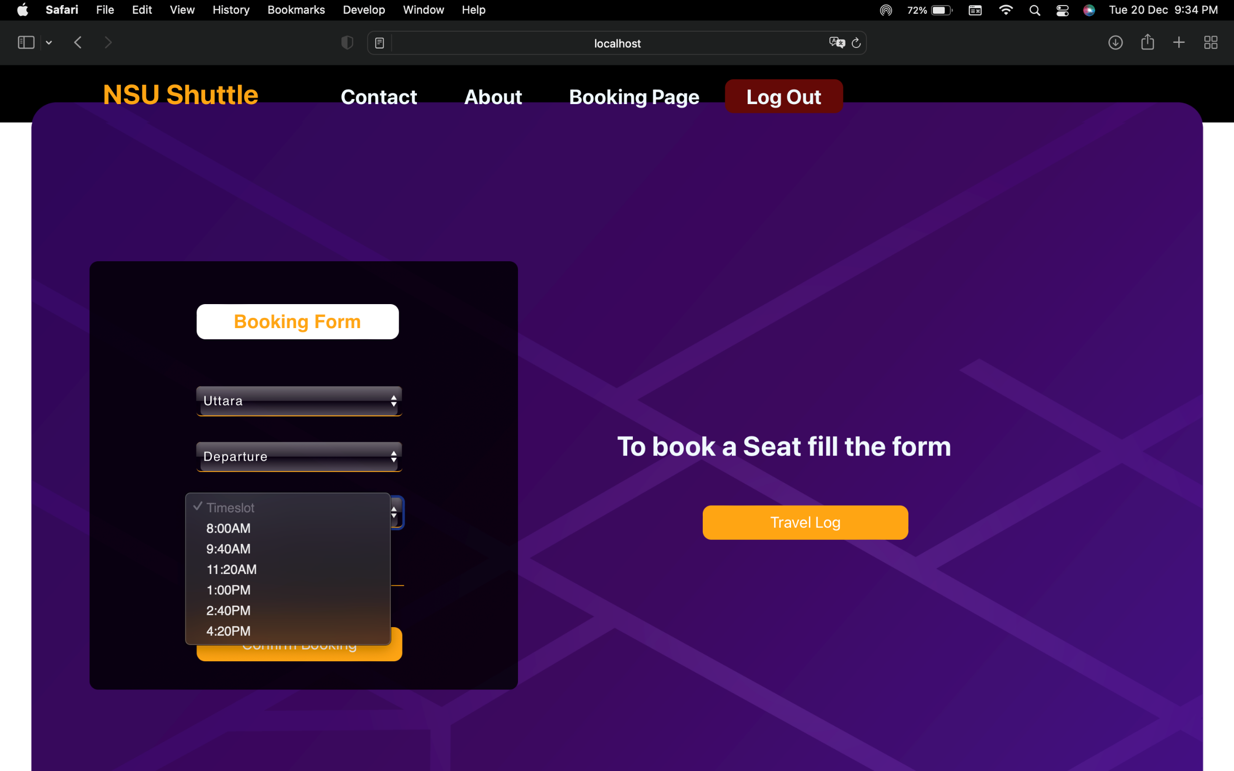
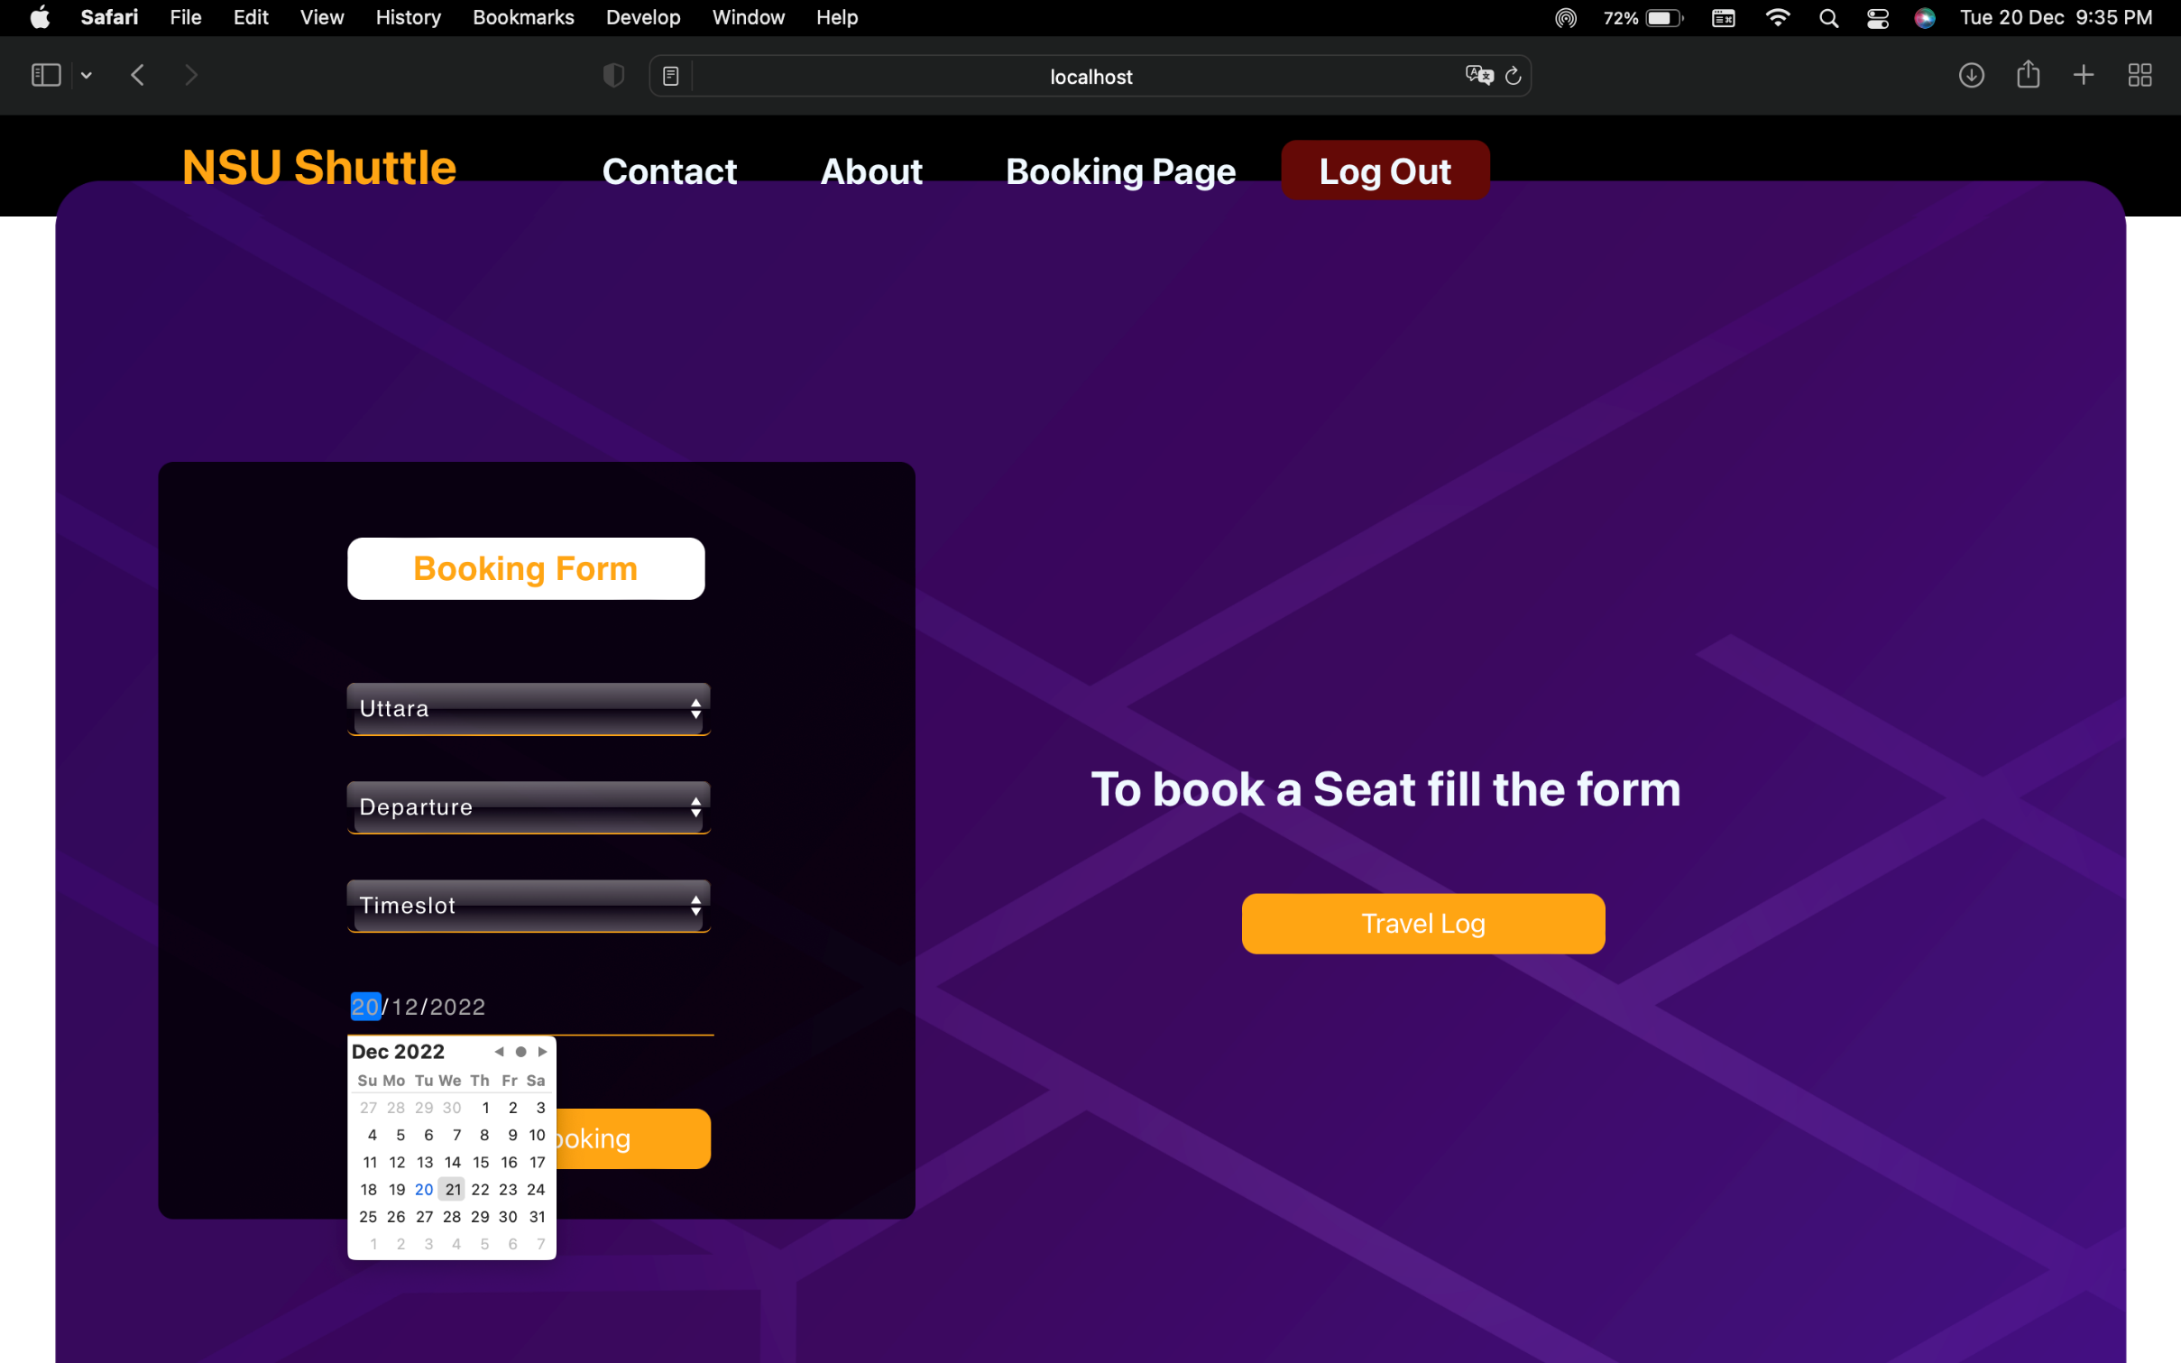
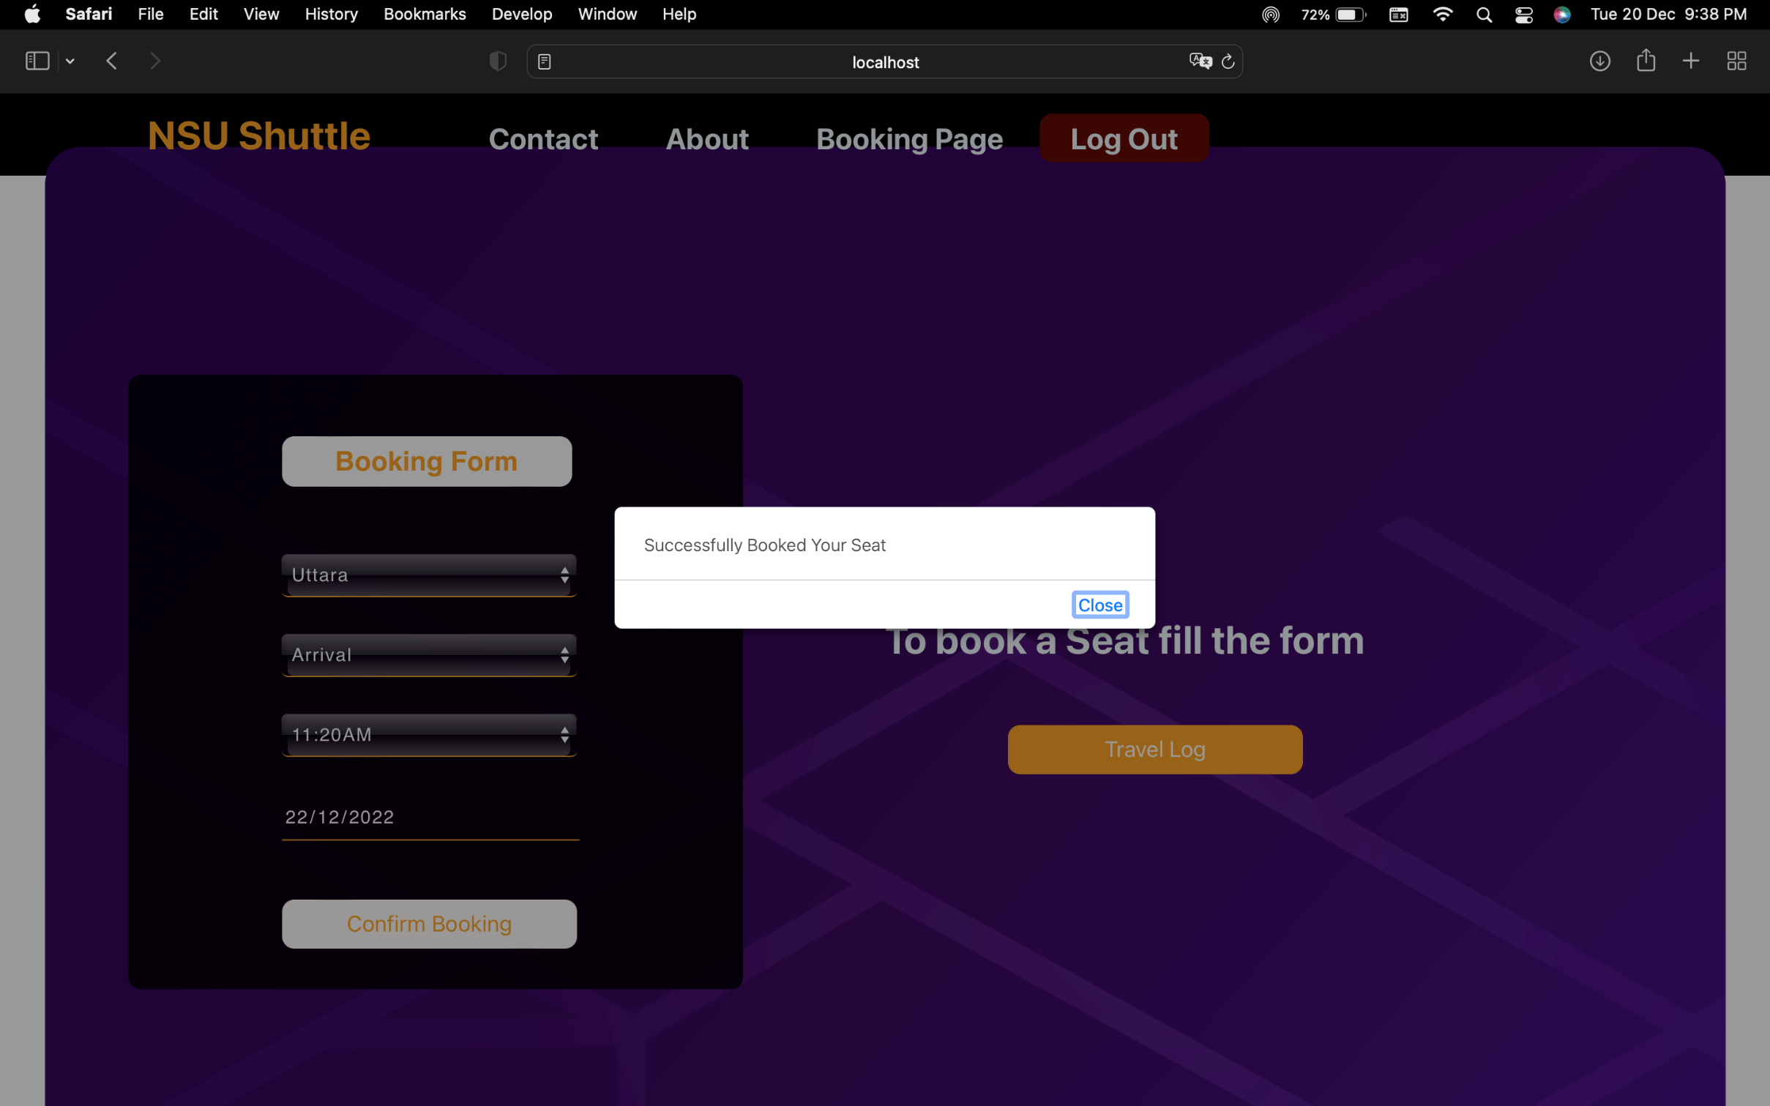
Implementation & Testing:

Slide 16
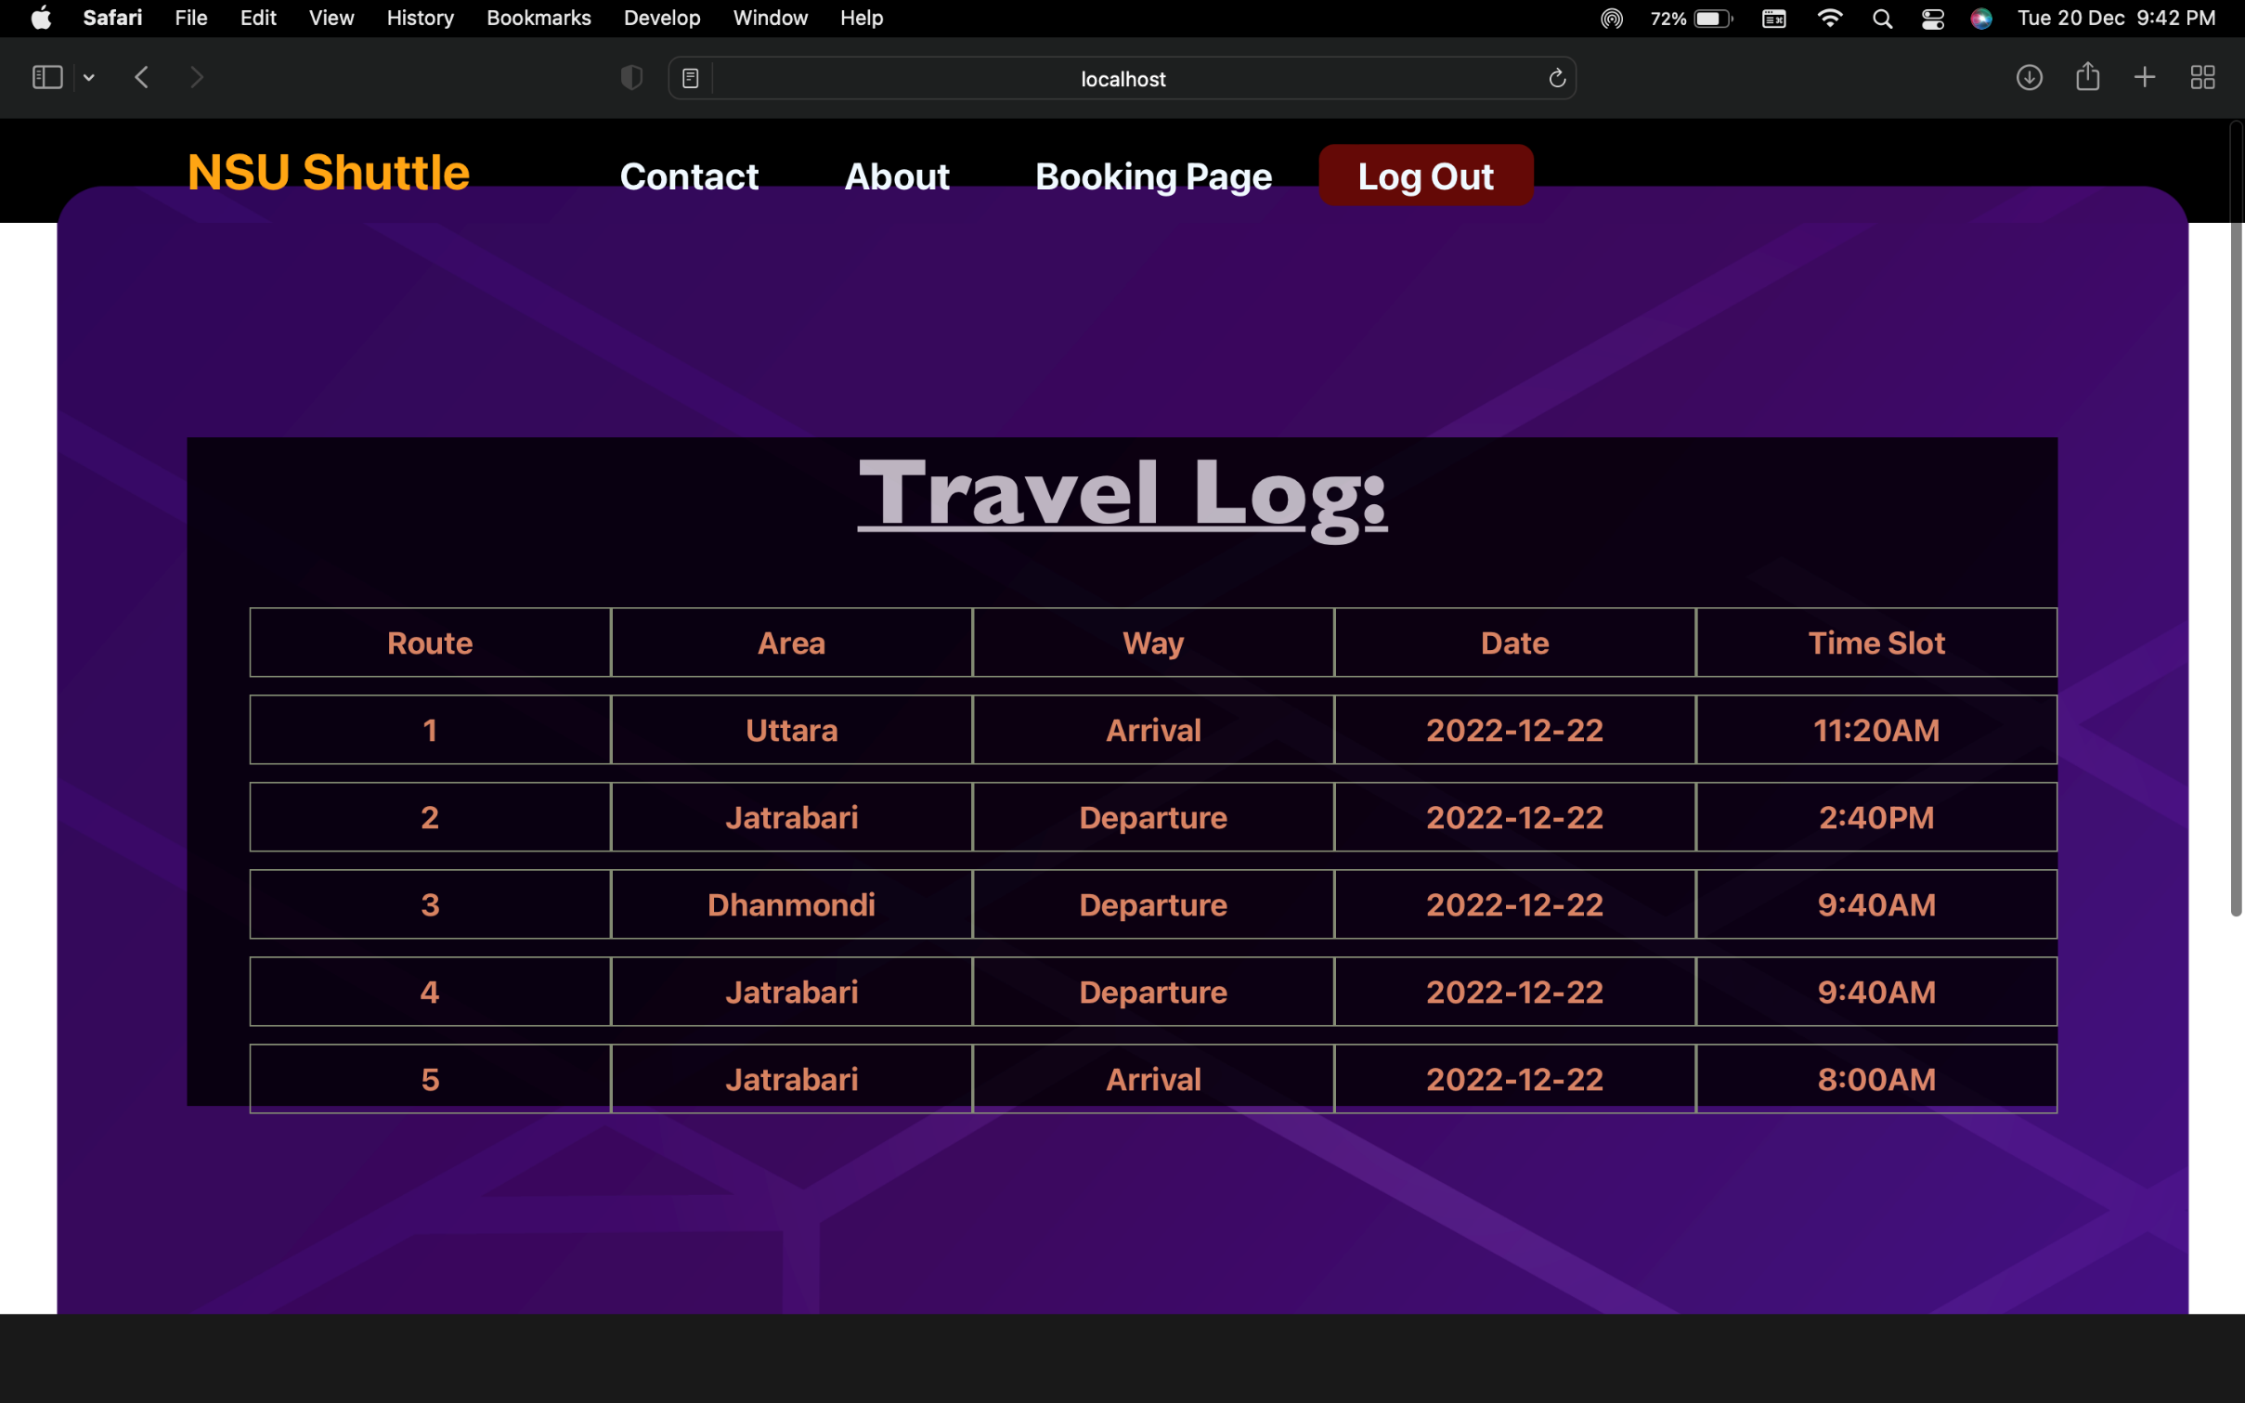
Implementation & Testing:

Slide 17

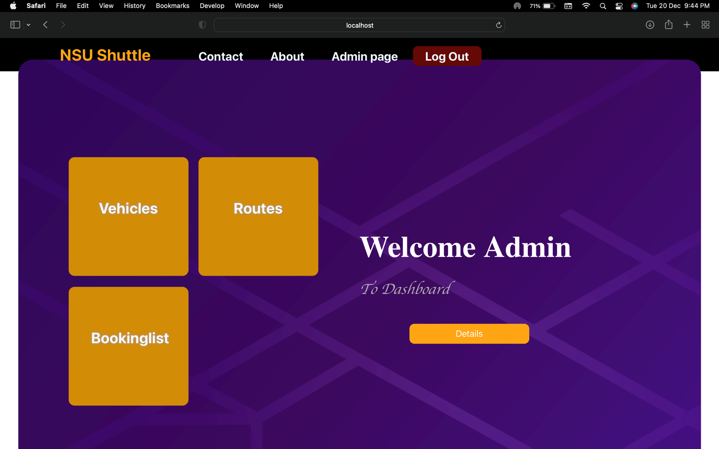
Implementation & Testing:

Slide 18
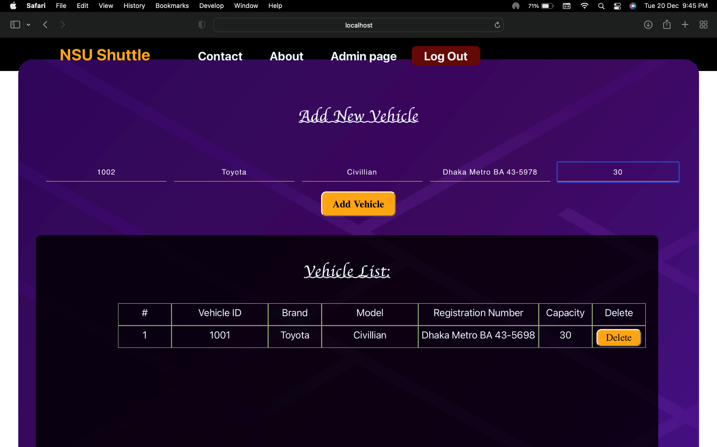
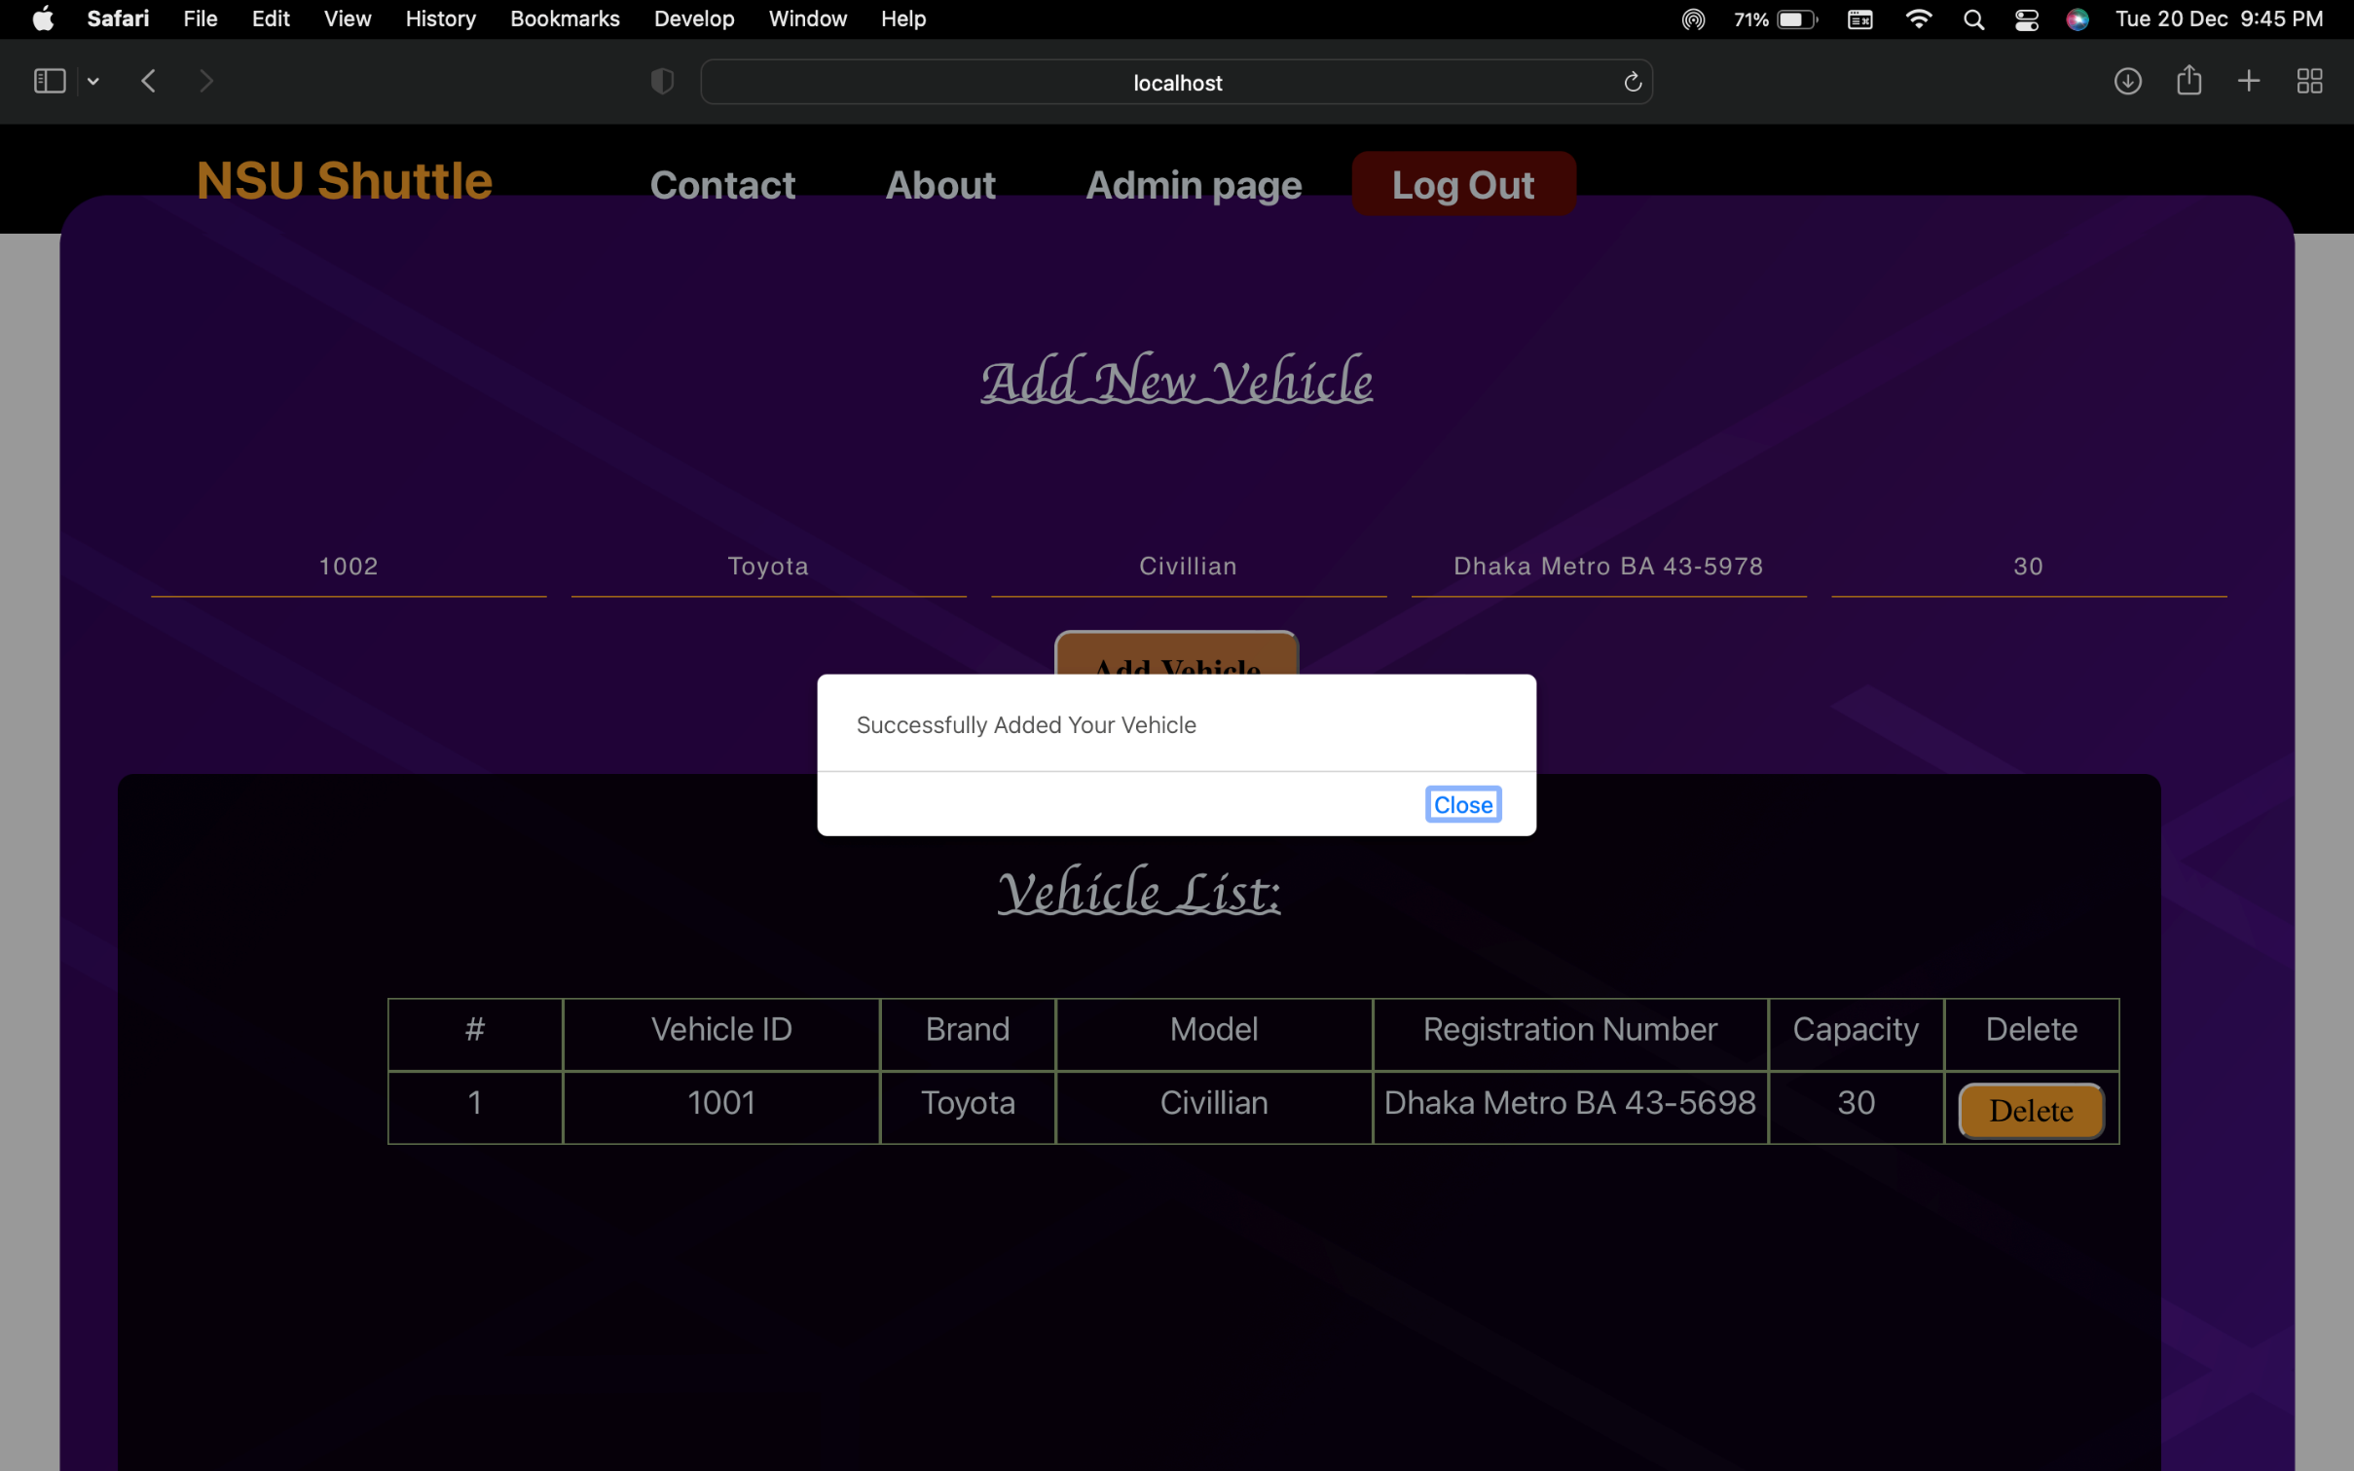
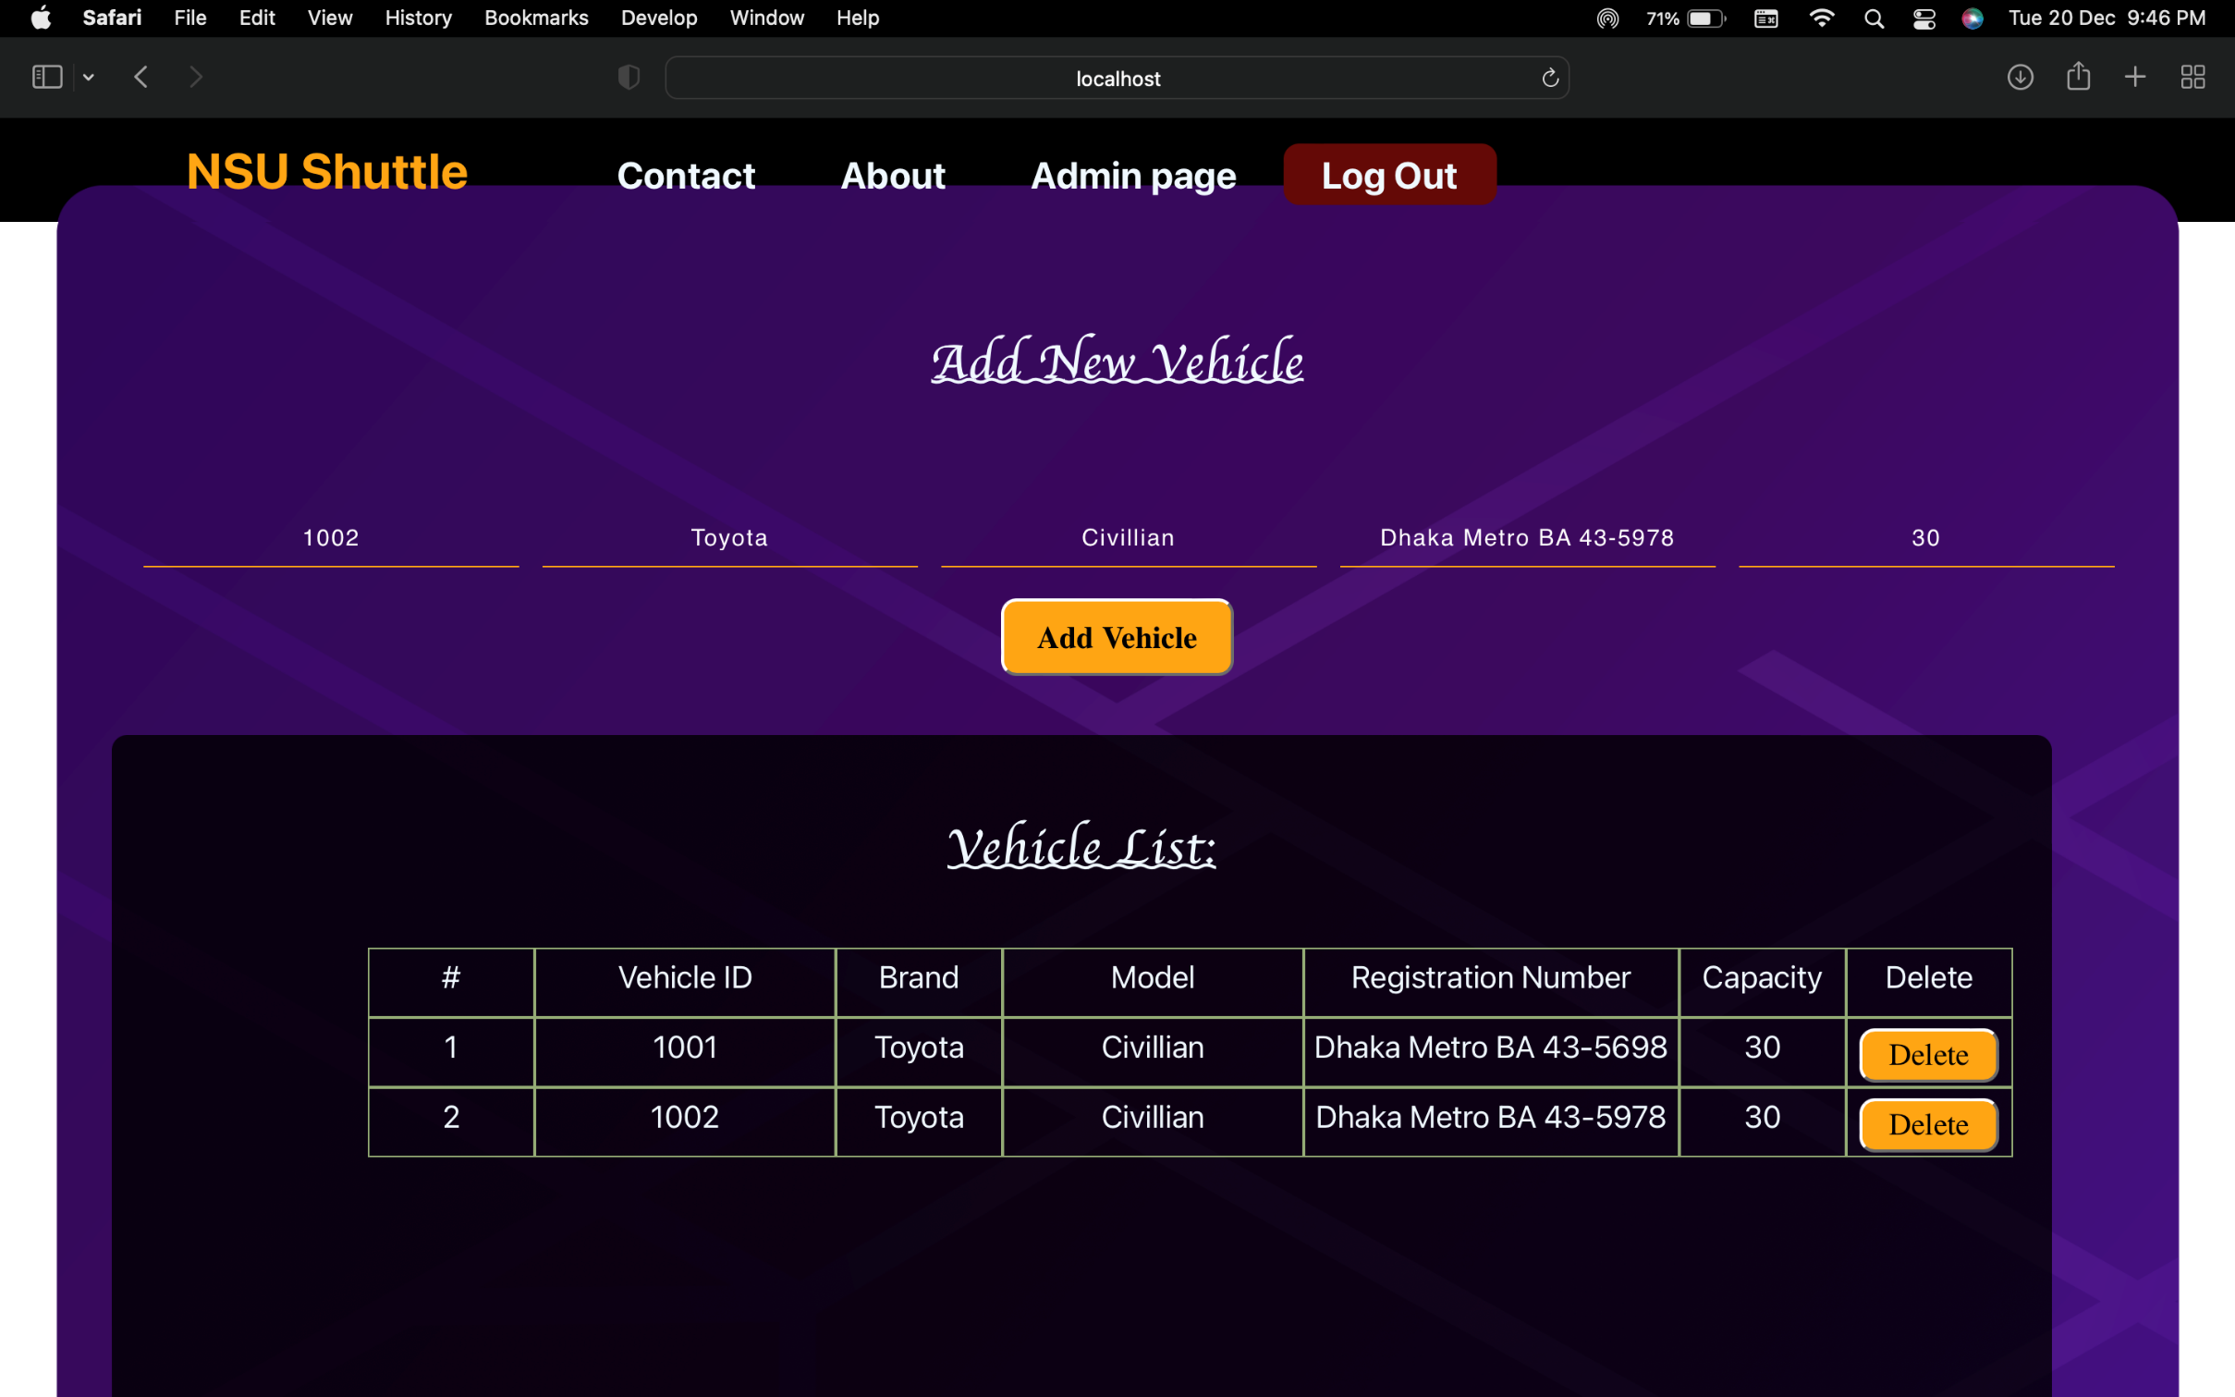
Implementation & Testing:

Slide 19
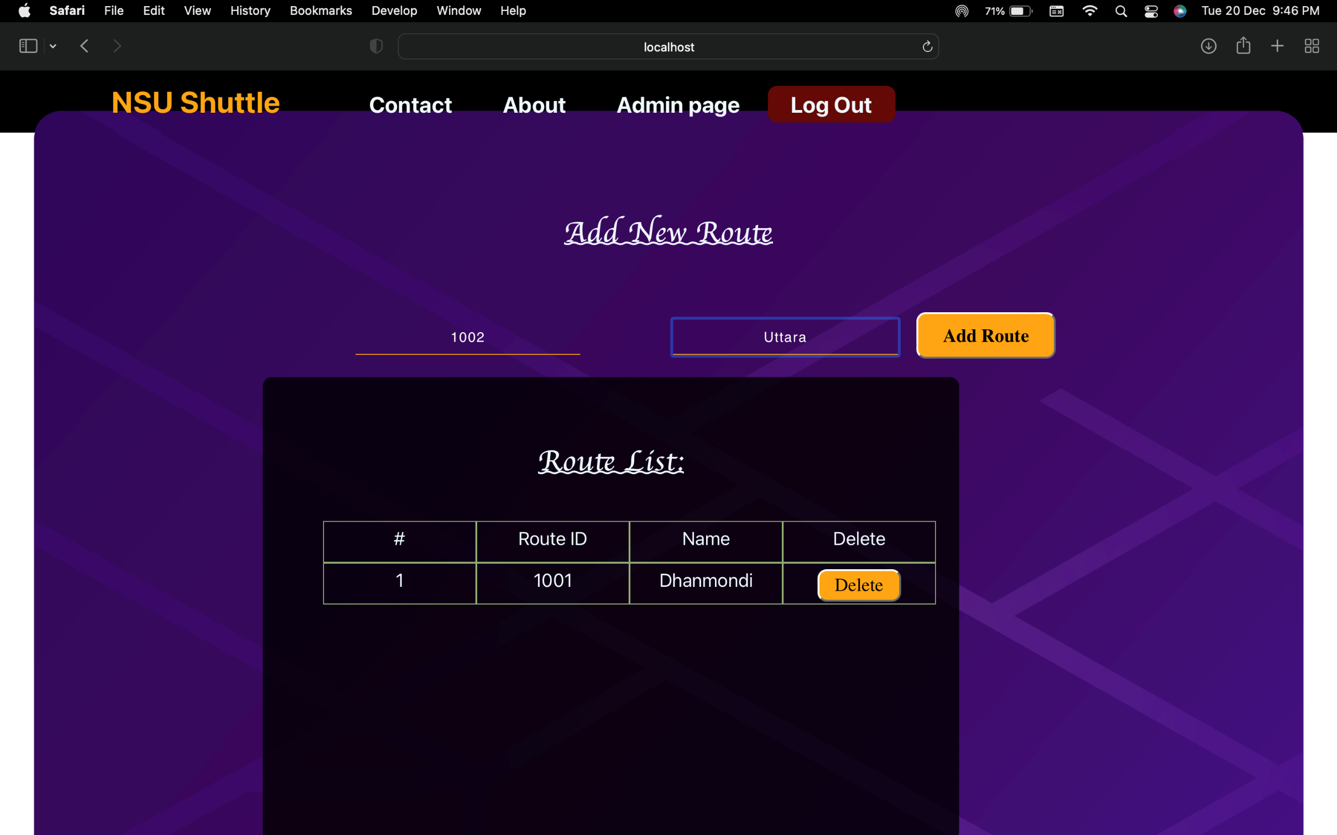
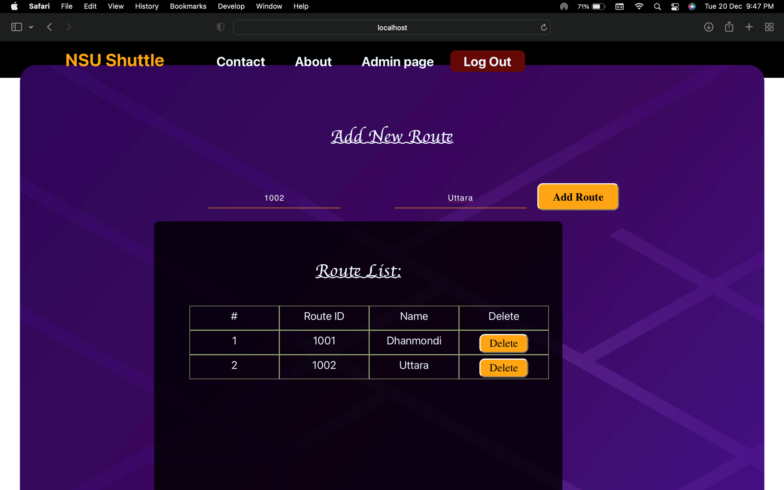
Implementation & Testing:

Slide 20
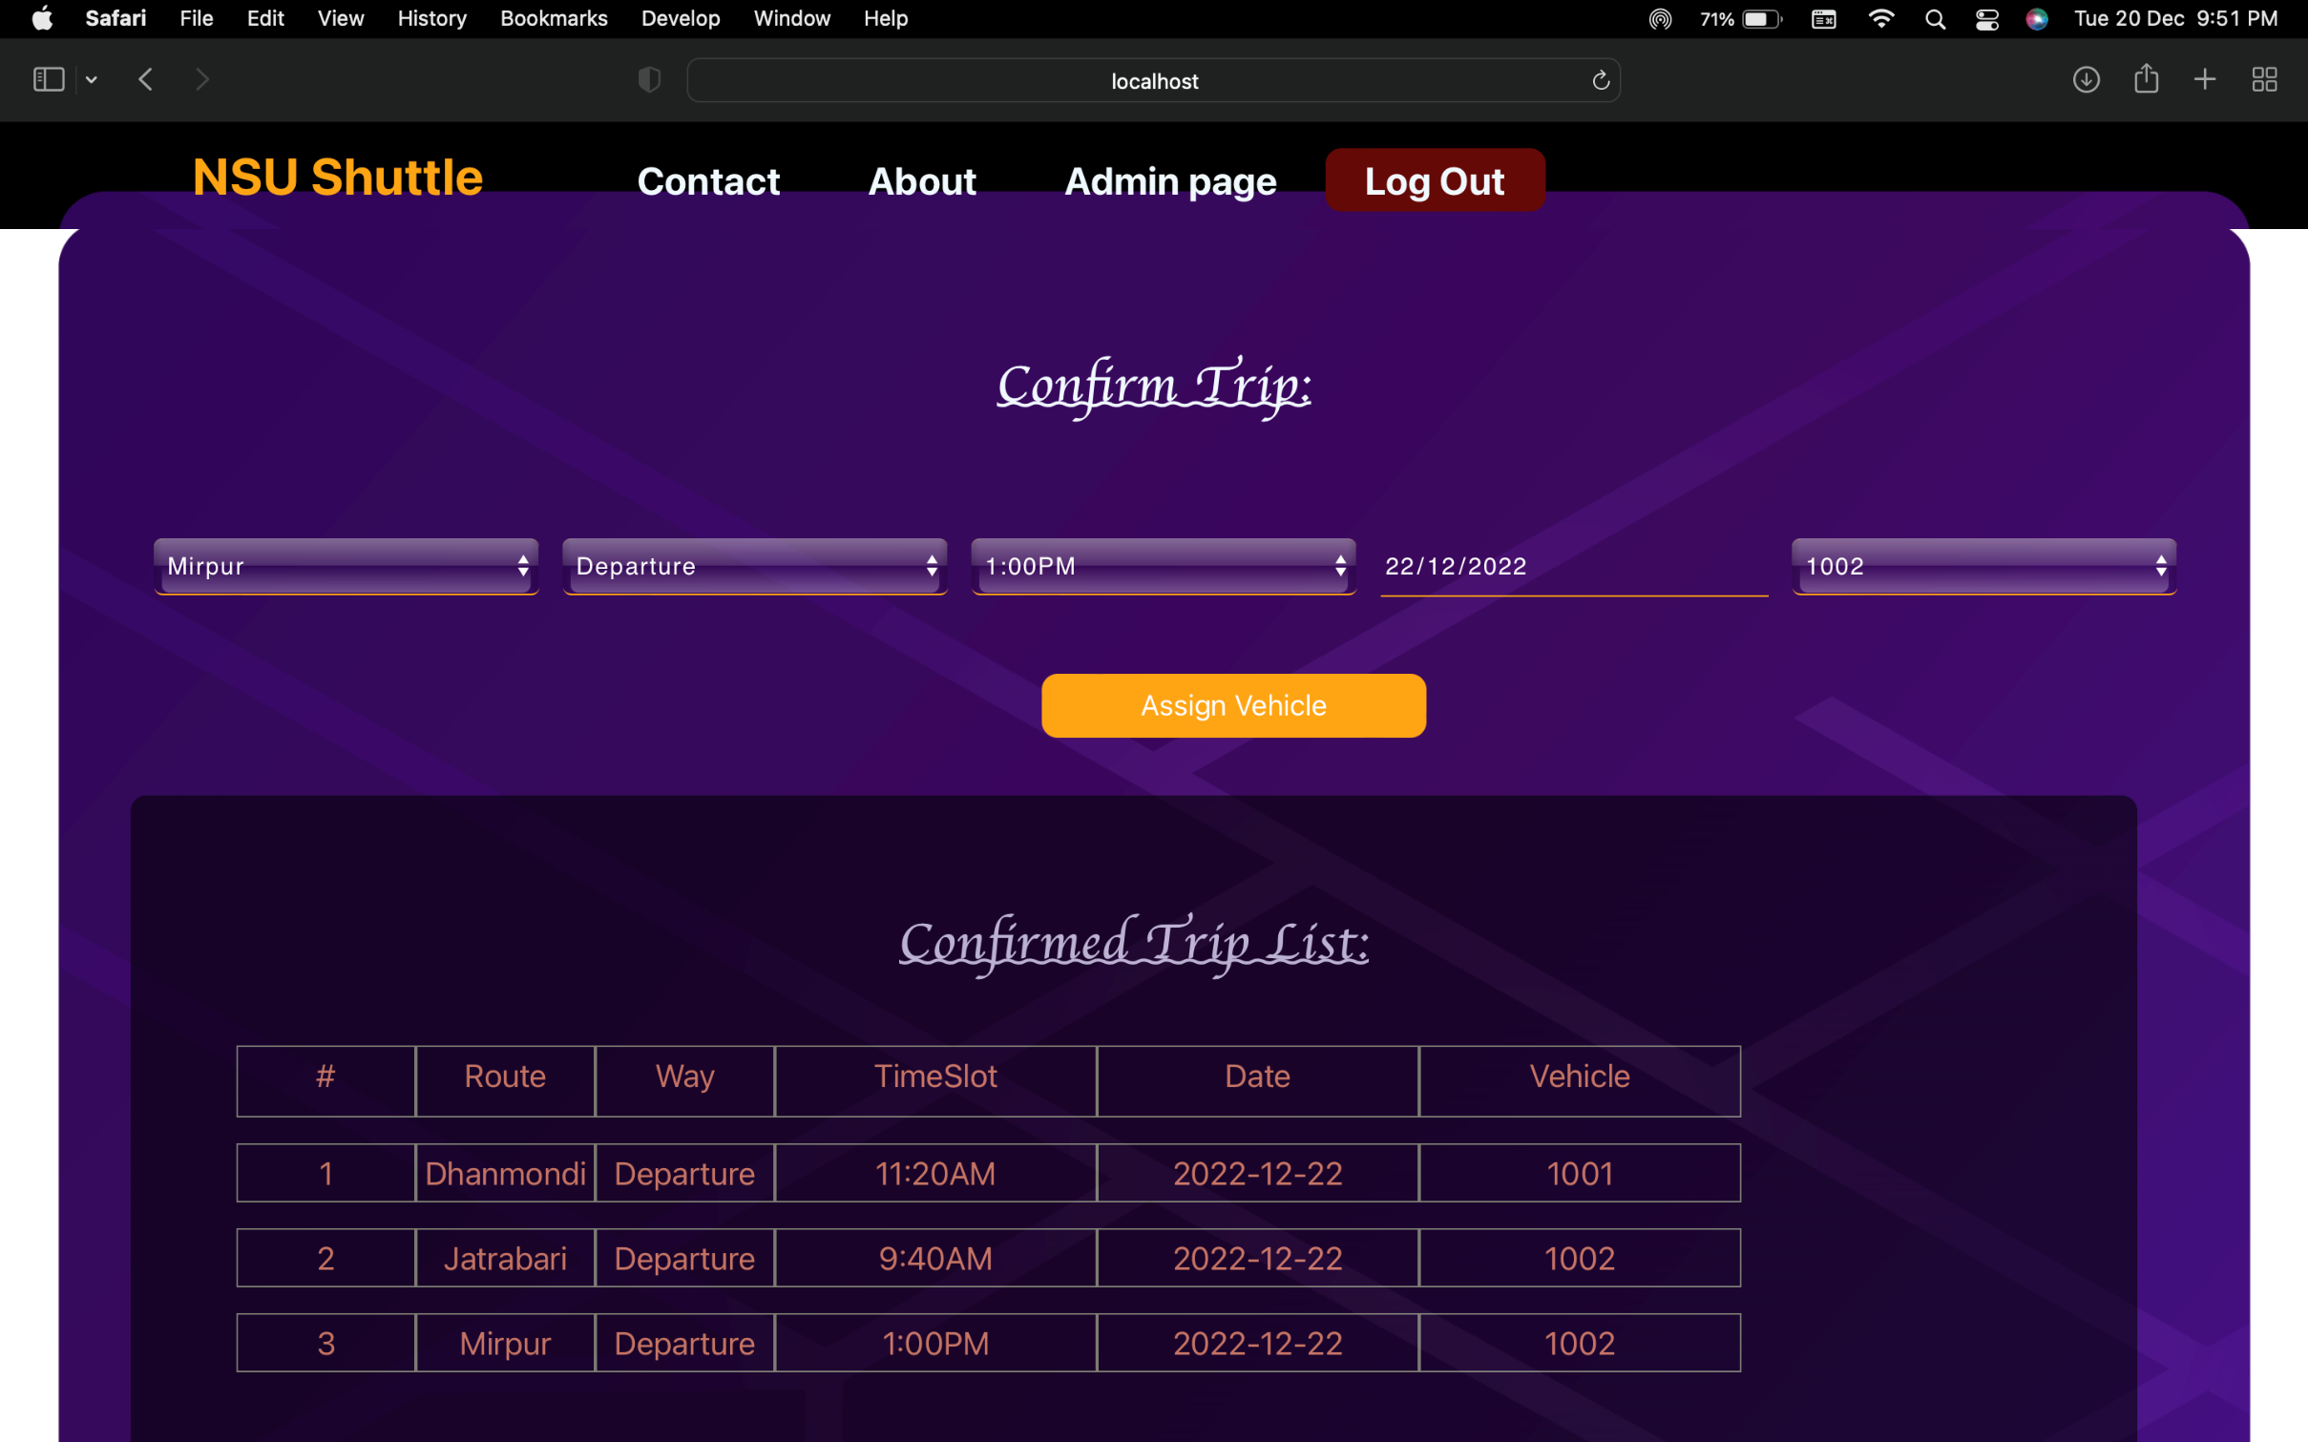
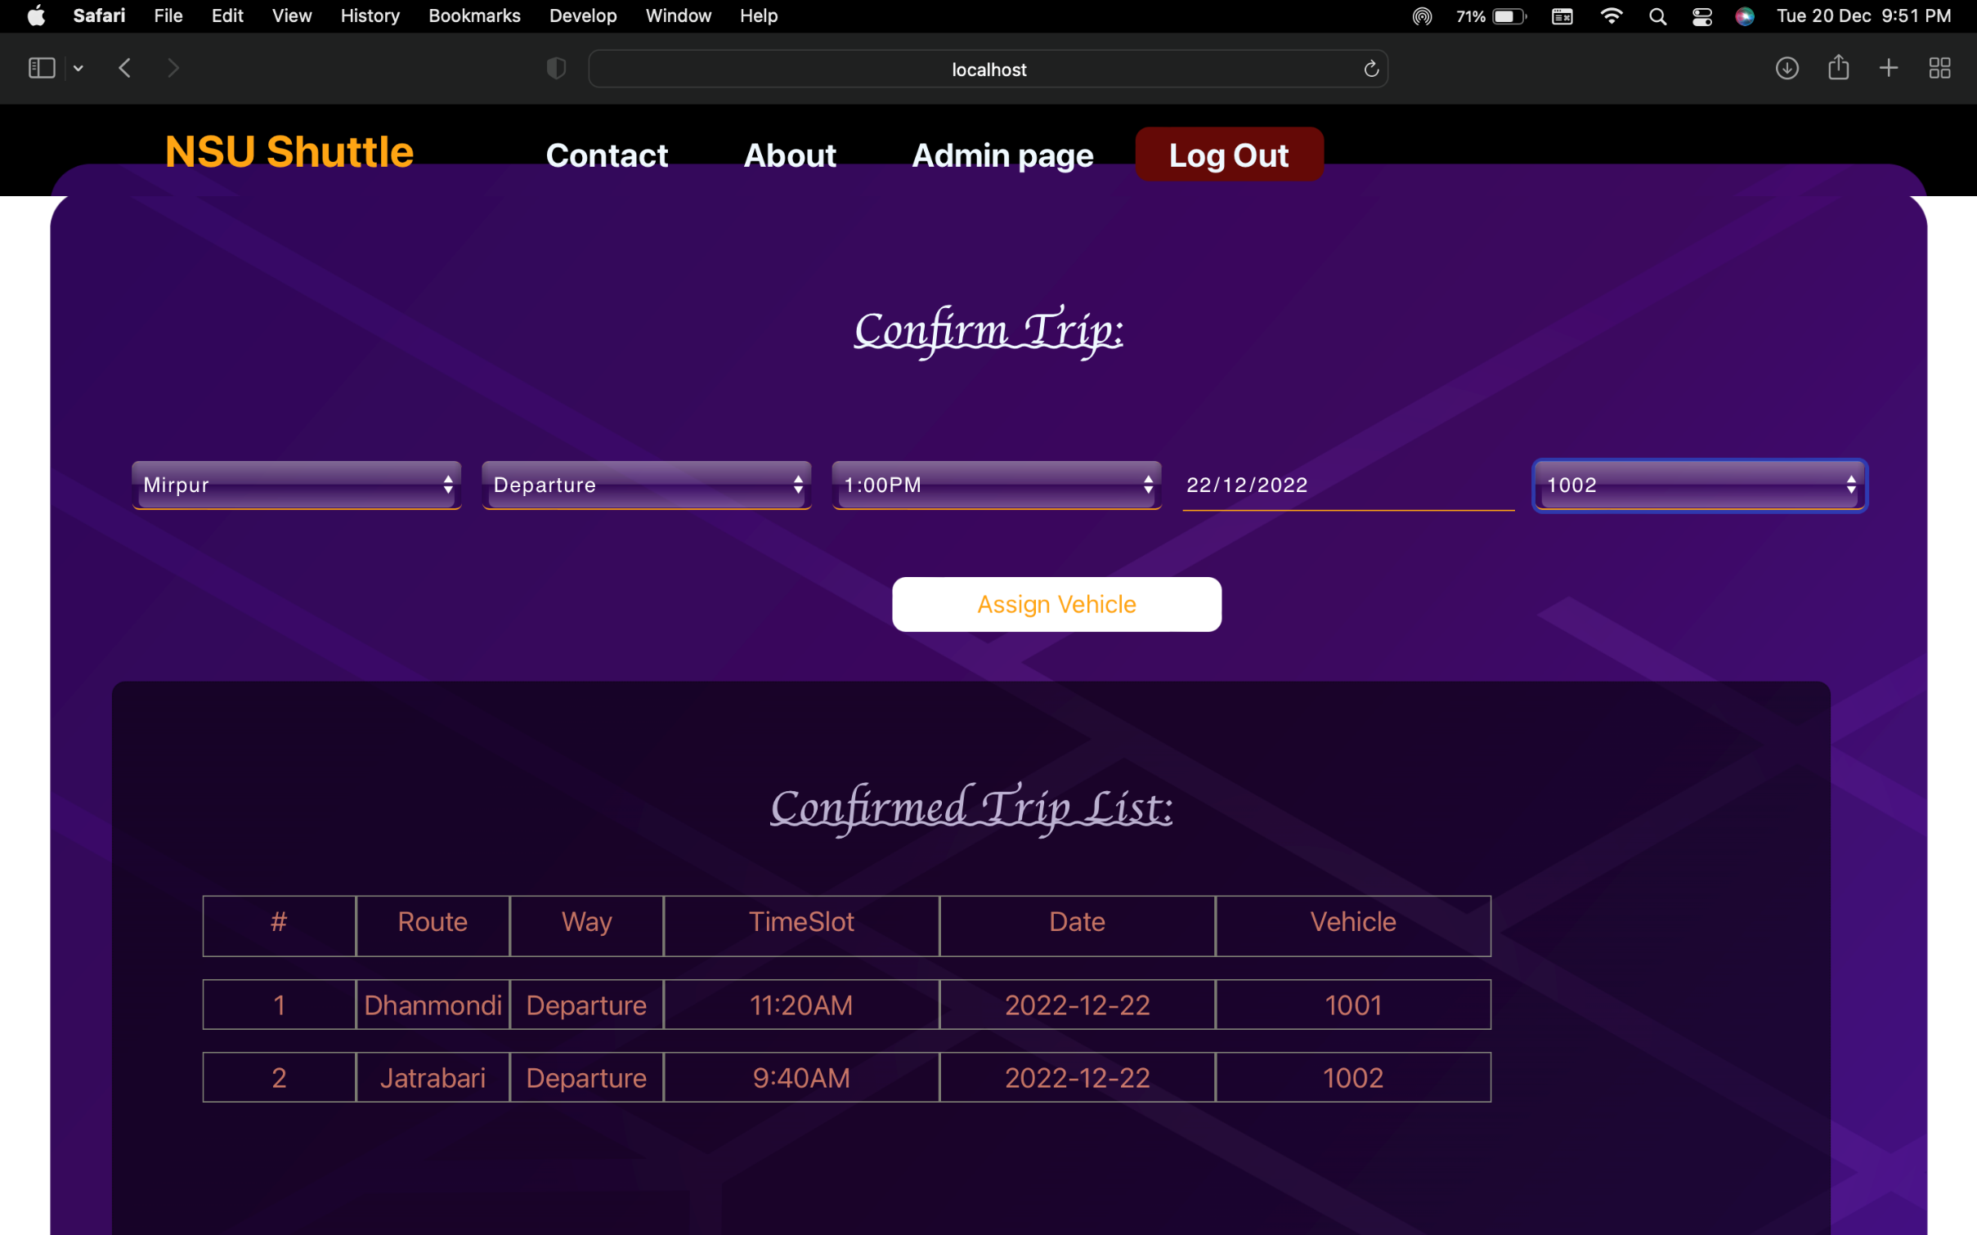
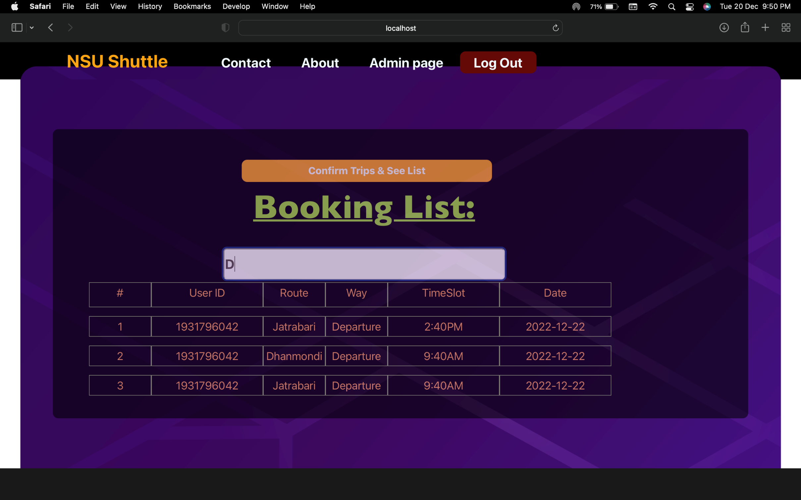
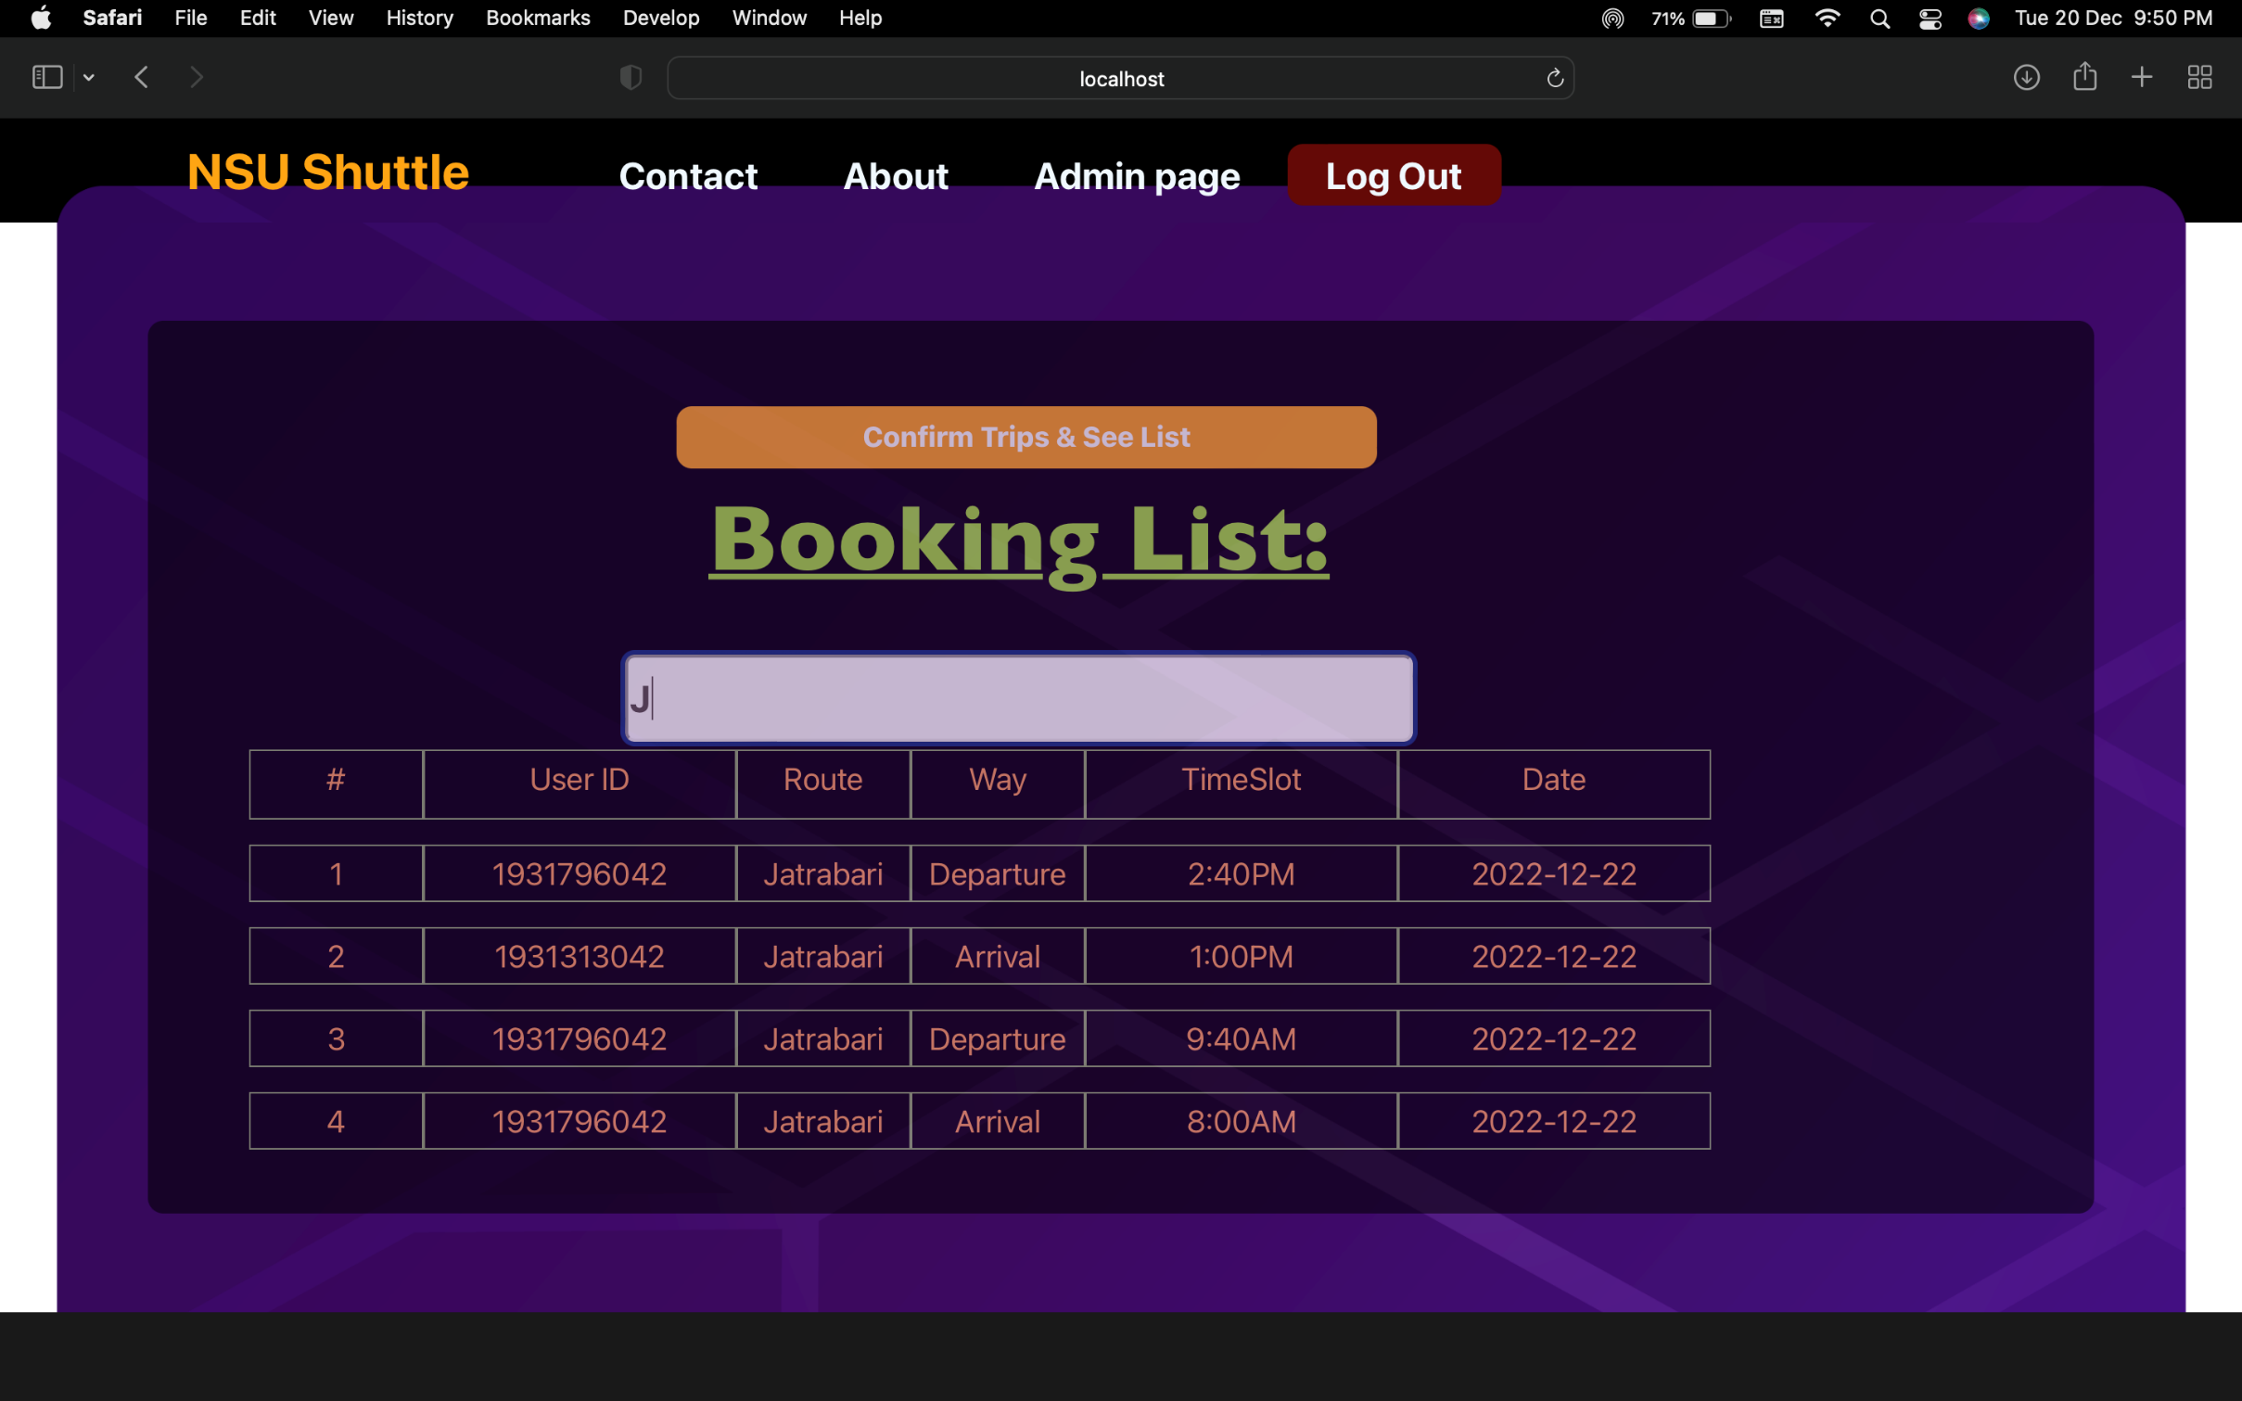
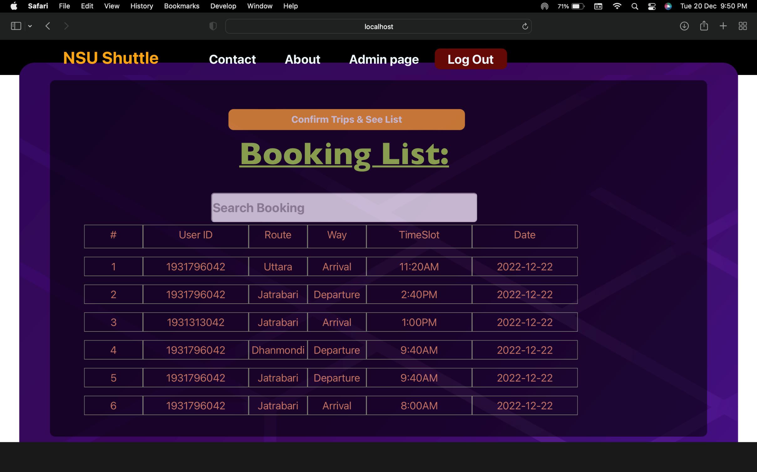
Implementation & Testing:

Slide 21
Limitations & Future Works
Count passengers ( We tried a lot but could not implement)
Cancel Booking (We could not complete due to time constrain)

